Slide 1



Compatible Intrinsic Triangulations
高山 健志
VC+VCC 2022 SIGGRAPH招待講演セッション2

Slide 2
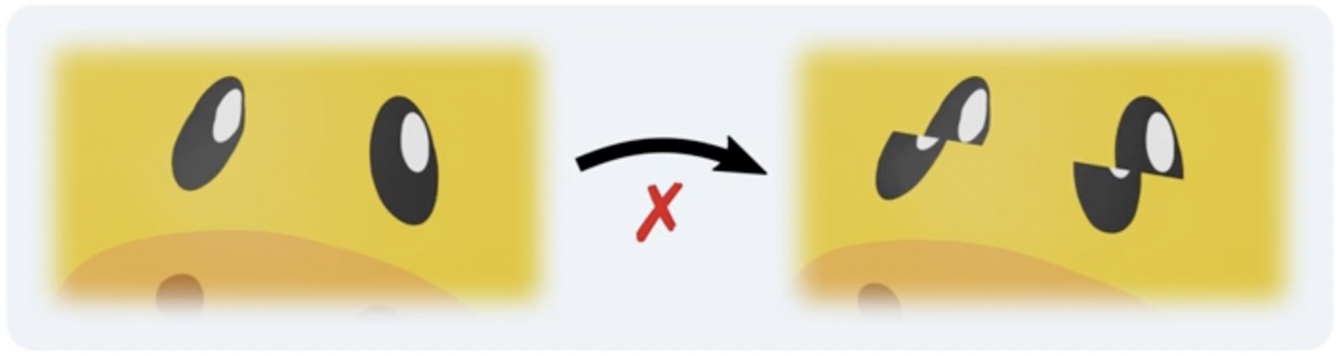
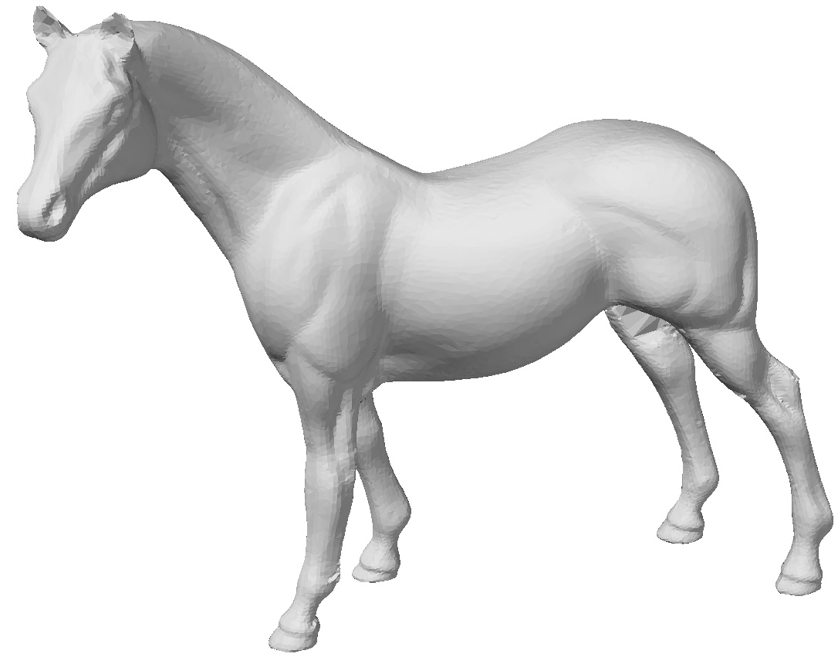
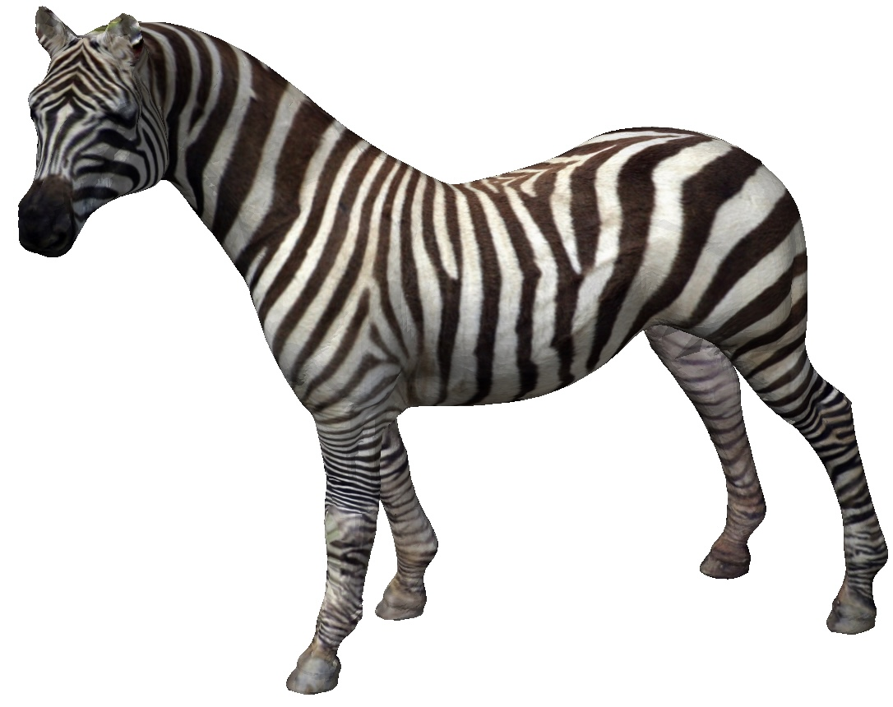
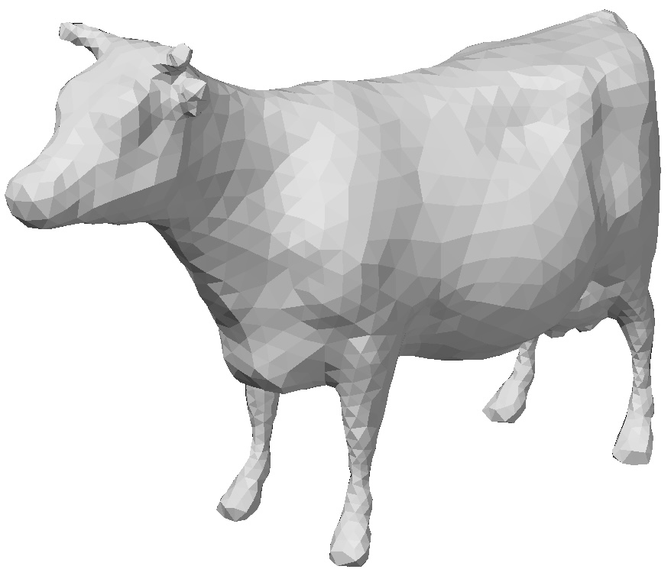
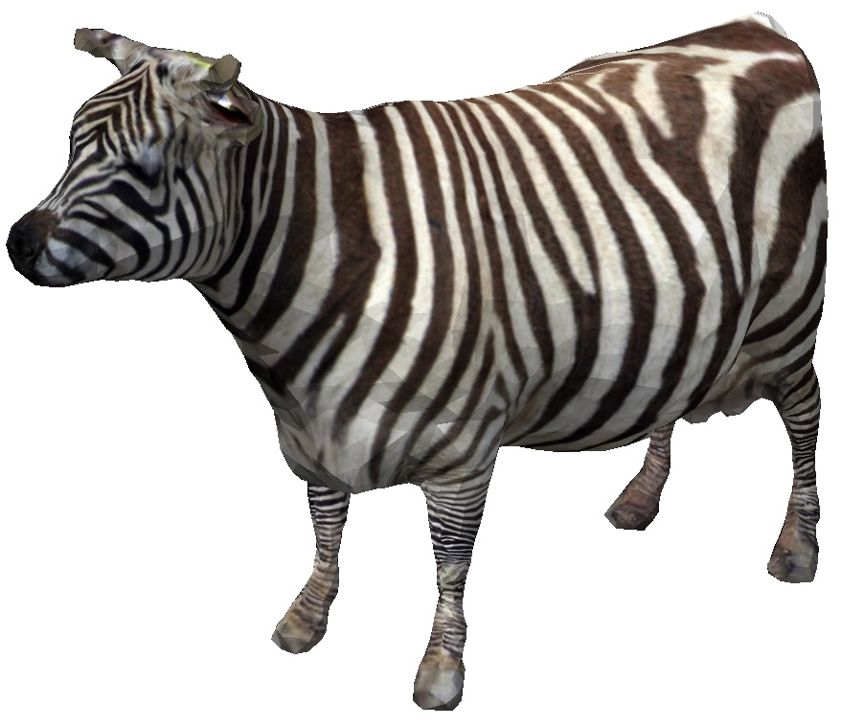
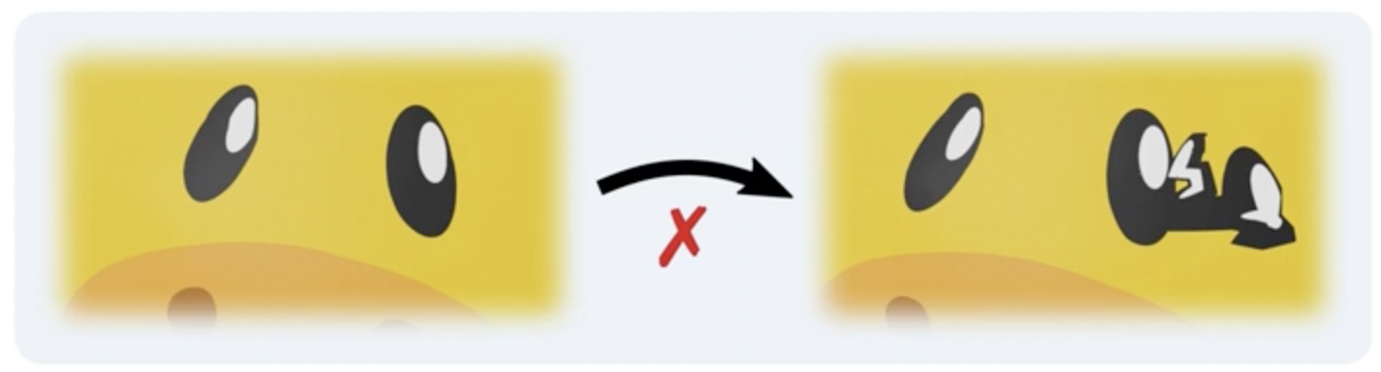
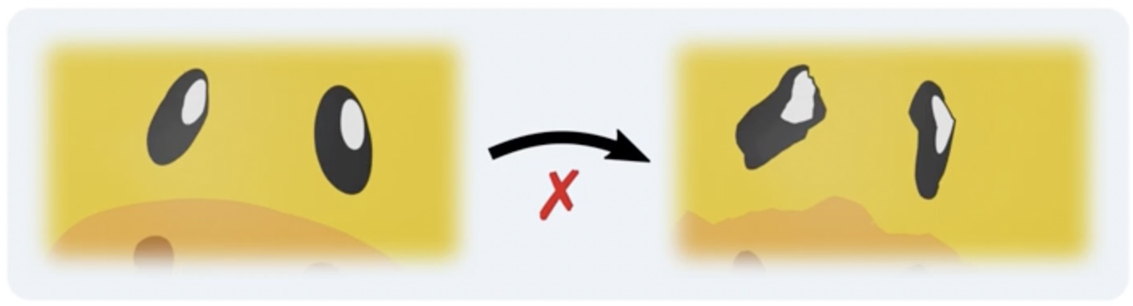
Inter-surface mapping
重要な性質
連続性
全単射性
歪み小
用途: テクスチャ転写 etc.
計算が難しい!
同相写像
Notes:
This work is about inter-surface mapping, which is about finding correspondences between points on two surfaces of the same genus.
<NEXT> There are 3 key properties that we want to have in such maps:
<NEXT> continuity,
<NEXT> bijectivity,
<NEXT> and low distortion.
<NEXT> Maps that have the first two properties are called homeomorphisms, and we specifically target this type of maps.
<NEXT> Such maps are useful for transferring various kind of data on surfaces,
<NEXT> <NEXT> such as texture, displacement, tessellation, and so on.
<NEXT> And in general, they are difficult to compute!

Slide 3
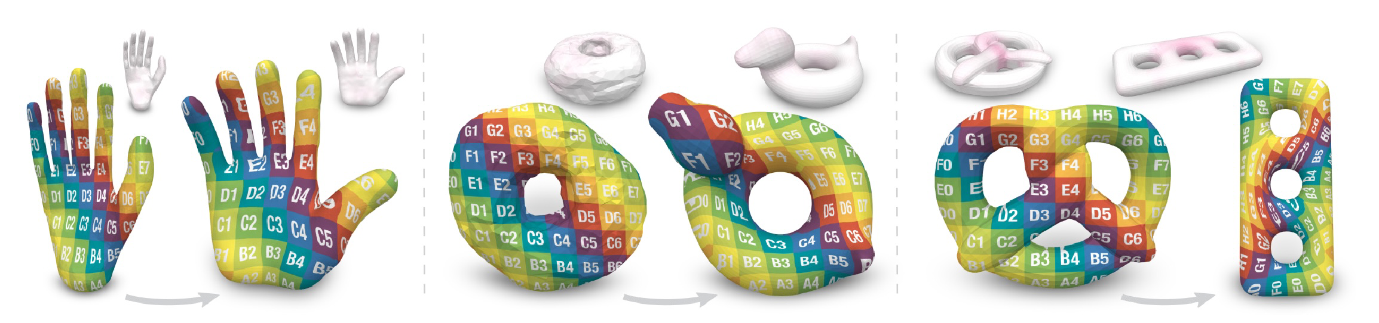
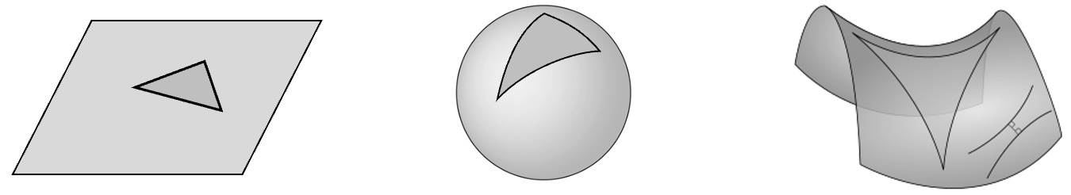
先行研究 [Schmidt 2020]
強み:
✓ 同相写像の保証
✓ End-to-endな最適化
✓ 任意の種数
高度な理論 (uniformization)
中間ドメインを経由して計算
美しいが、理解しにくい！
実装が難しそう…
Notes:
There is of course a literature on surface homeomorphisms, and all previous methods use some form of intermediate domains,
<NEXT> such as plane,
<NEXT> sphere,
<NEXT> hyperbolic plane,
<NEXT> or base complex.
<NEXT> These are all technically sound, but they tend to make the algorithm quite a bit complicated.
<NEXT> In particular, global and end-to-end distortion minimization becomes challenging in this context.
<NEXT> And there are only 3 papers so far that addressed this issue.
<NEXT> The two on the right can handle disk-topology surfaces only,
<NEXT> and the one on the left can handle closed surfaces of arbitrary topology, so it is considered the current state of the art.

Slide 4
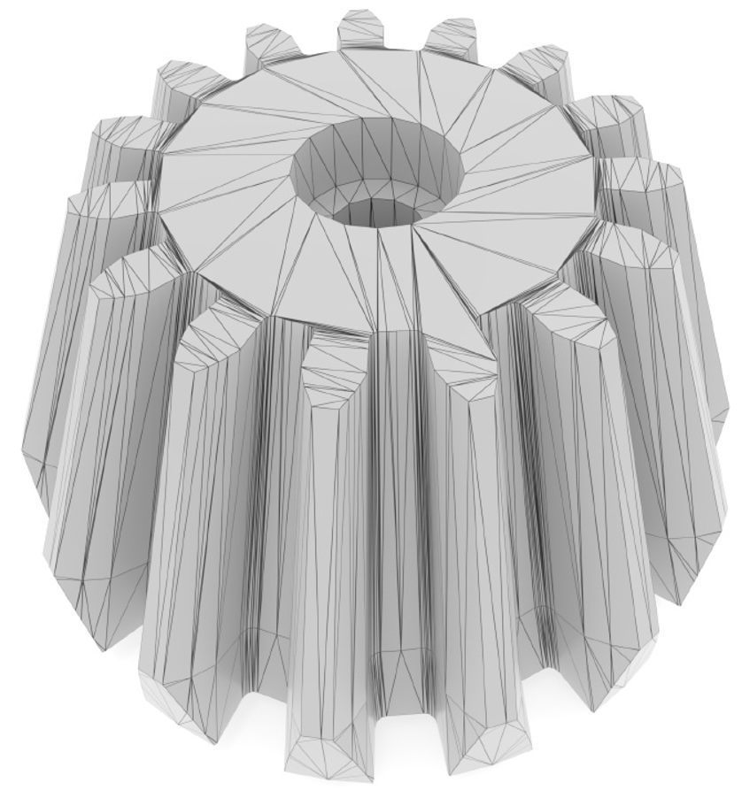
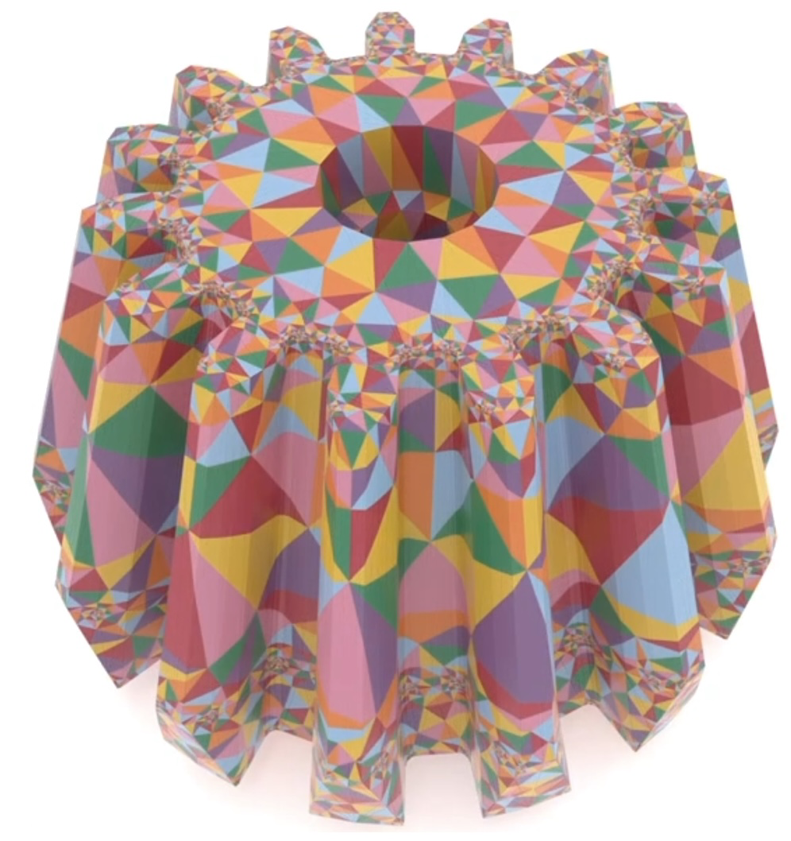

本研究の位置づけ
先行研究 [Schmidt 2020] よりも単純で直感的な方法
中間ドメインを経由しない
カギ: intrinsic triangulations
元々の用途: サーフェス上でPDEをロバストに解く
DISCLAIMER:
実用上の優位性は無い (!)
経験則に基づく方法、ロバスト性で劣る
後続研究を促す (という期待)
難しい問題に対する新しい視点
ソースコードの公開
[Sharp 2019]
https://github.com/kenshi84/compatible-intrinsic-triangulations
Notes:
That said, our contribution is a simpler and more intuitive alternative to the state of the art.
In particular, our method does not involve any intermediate domains.
<NEXT> The key to our method is the use of the intrinsic triangulations technique.
Its original aim was to solve PDEs on surfaces robustly.
We show its new usage for the problem of inter-surface mapping.
<NEXT> Before moving on, I just want to be honest and make it clear: our method does not offer any practical advantage over the state of the art.
Our method is designed purely empirically, and is less robust than the state of the art.
<NEXT> The main point of this work is to stimulate research in this field by providing a new perspective, and also releasing the source code so that others can build on top of it.

Slide 5
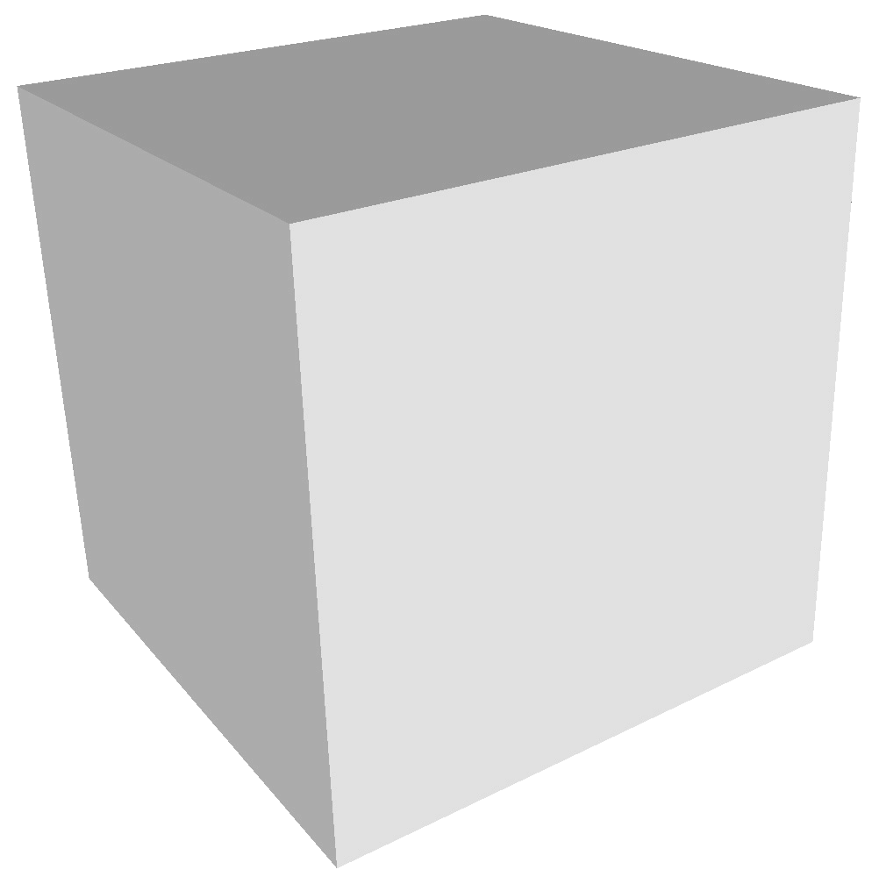
背景: intrinsic triangulations
普通の extrinsic triangulation から出発
局所的な操作を適用:
Intrinsic edge flip
Notes:
OK, here’s a quick recap of the intrinsic triangulations technique.
We always start with an extrinsic triangulation, which is just an ordinary triangle mesh.
<NEXT> From here, we can apply some local operations.
<NEXT> The first basic operation is intrinsic edge flip.
For example, if we are to flip this edge,
<NEXT> we take its two adjacent triangles and flatten them to 2D.
<NEXT> Then we flip the edge in 2D and obtain new triangle shapes.
<NEXT> These triangles are then mapped back to the surface in 3D.
They get bent across the edges of the original mesh, but we don’t care, as long as they can be flattened to 2D isometrically.

Slide 6
背景: intrinsic triangulations
普通の extrinsic triangulation から出発
局所的な操作を適用 :
Intrinsic edge flip
Vertex insertion
様々な分割を無数に作れる!
Notes:
Another basic operation is vertex insertion.
For example, if we are to insert a vertex to this triangle,
<NEXT> we first flatten it to 2D,
<NEXT> then insert the vertex in 2D, splitting the triangle into three.
<NEXT> These new triangles are then mapped back to the surface in 3D.
<NEXT> Through these local operations, we can get infinitely many different tessellations over the same surface geometry defined by the original triangle mesh!

Slide 7
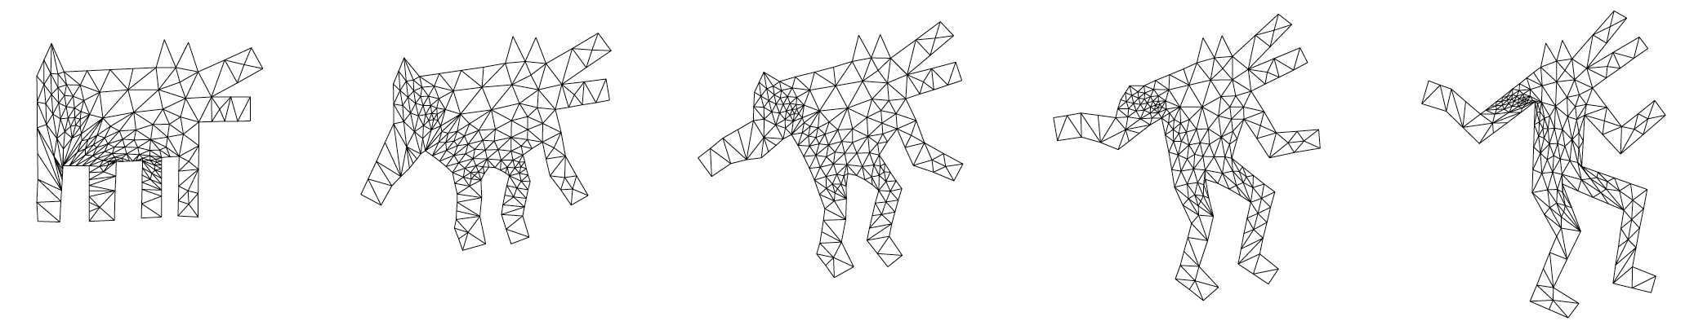
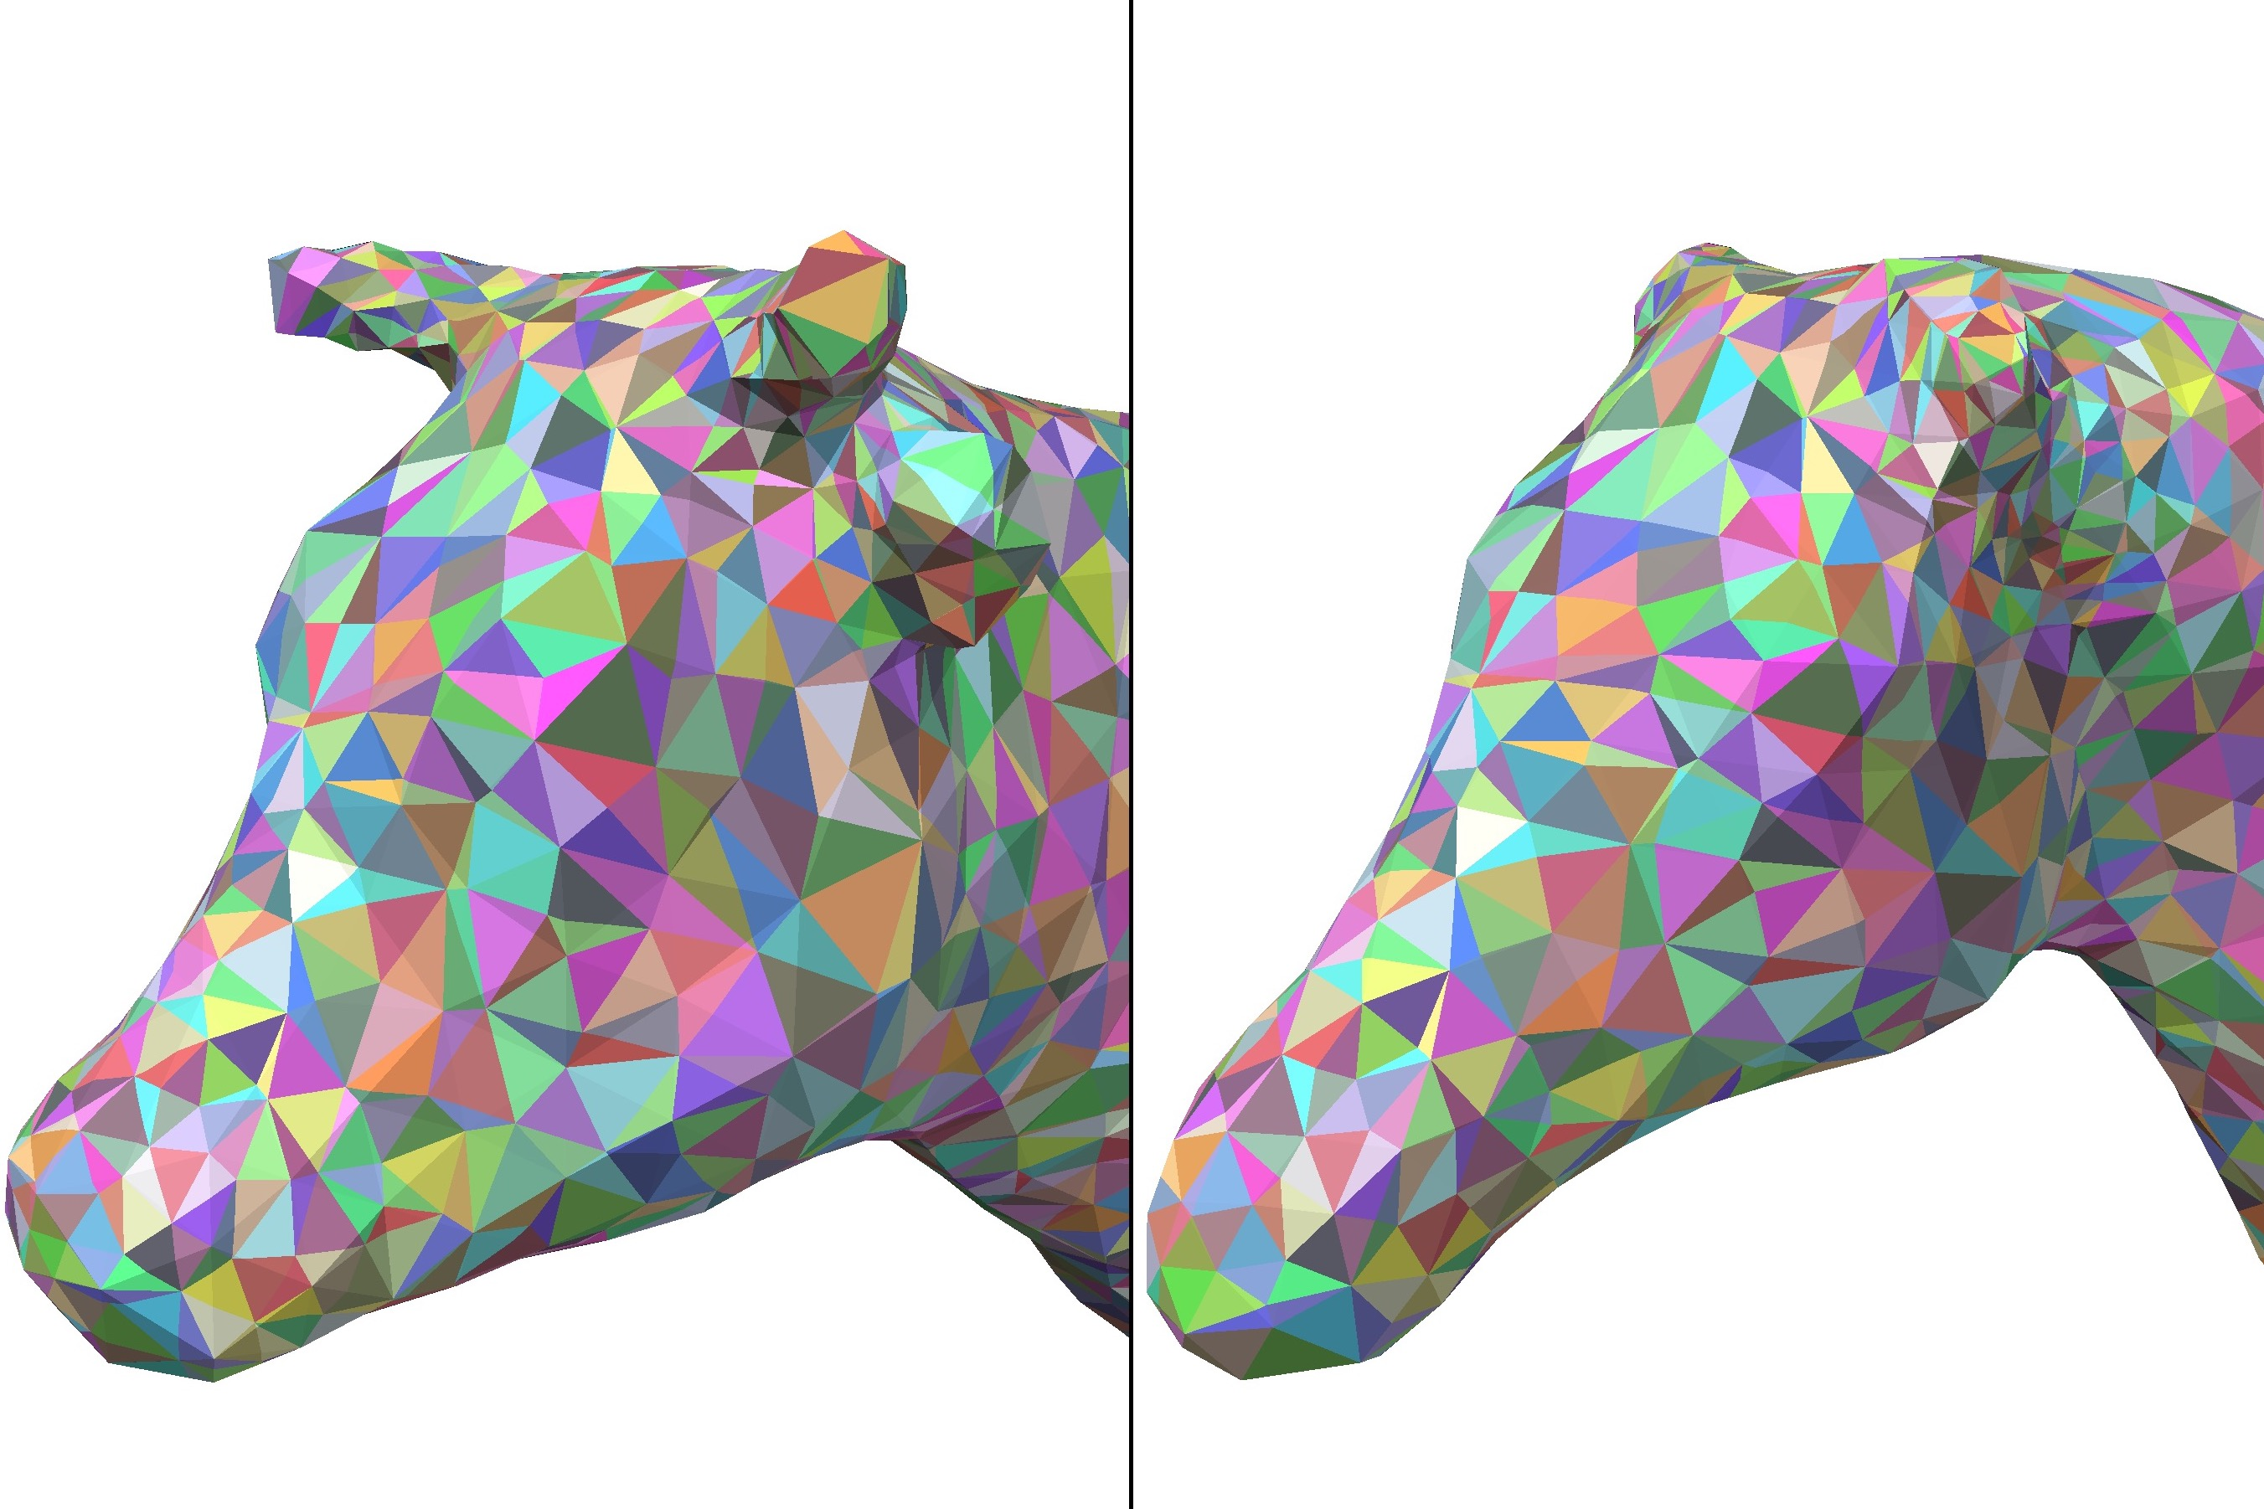
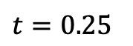
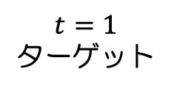
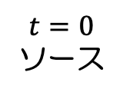
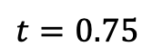
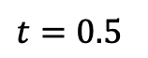
着想の元: 2Dにおける compatible triangulations
形状の補間に利用 [Alexa 2000]
自明に同相写像を定義する
同じことを、サーフェス上で intrinsic triangulations を使って 実現してみよう!
$$t=0$$
ソース
$$t=0.25$$
$$t=0.5$$
$$t=0.75$$
$$t=1$$
ターゲット
Notes:
Another source of our inspiration is the concept of compatible triangulations in 2D, which was used for shape interpolation.
In this example, a source shape on the left and a target shape on the right are interpolated using a compatible triangulation.
Here, every face is in 1-to-1 correspondence, as highlighted by colors in some faces.
<NEXT> So this trivially defines a homeomorphism between two 2D shapes.
<NEXT> So our question is: can we do the same on 3D surfaces, using intrinsic triangulations?
And the answer is yes, we can!

Slide 8
提案法: Compatible Intrinsic Triangulations
Notes:
So here comes our method, called Compatible Intrinsic Triangulations.

Slide 9
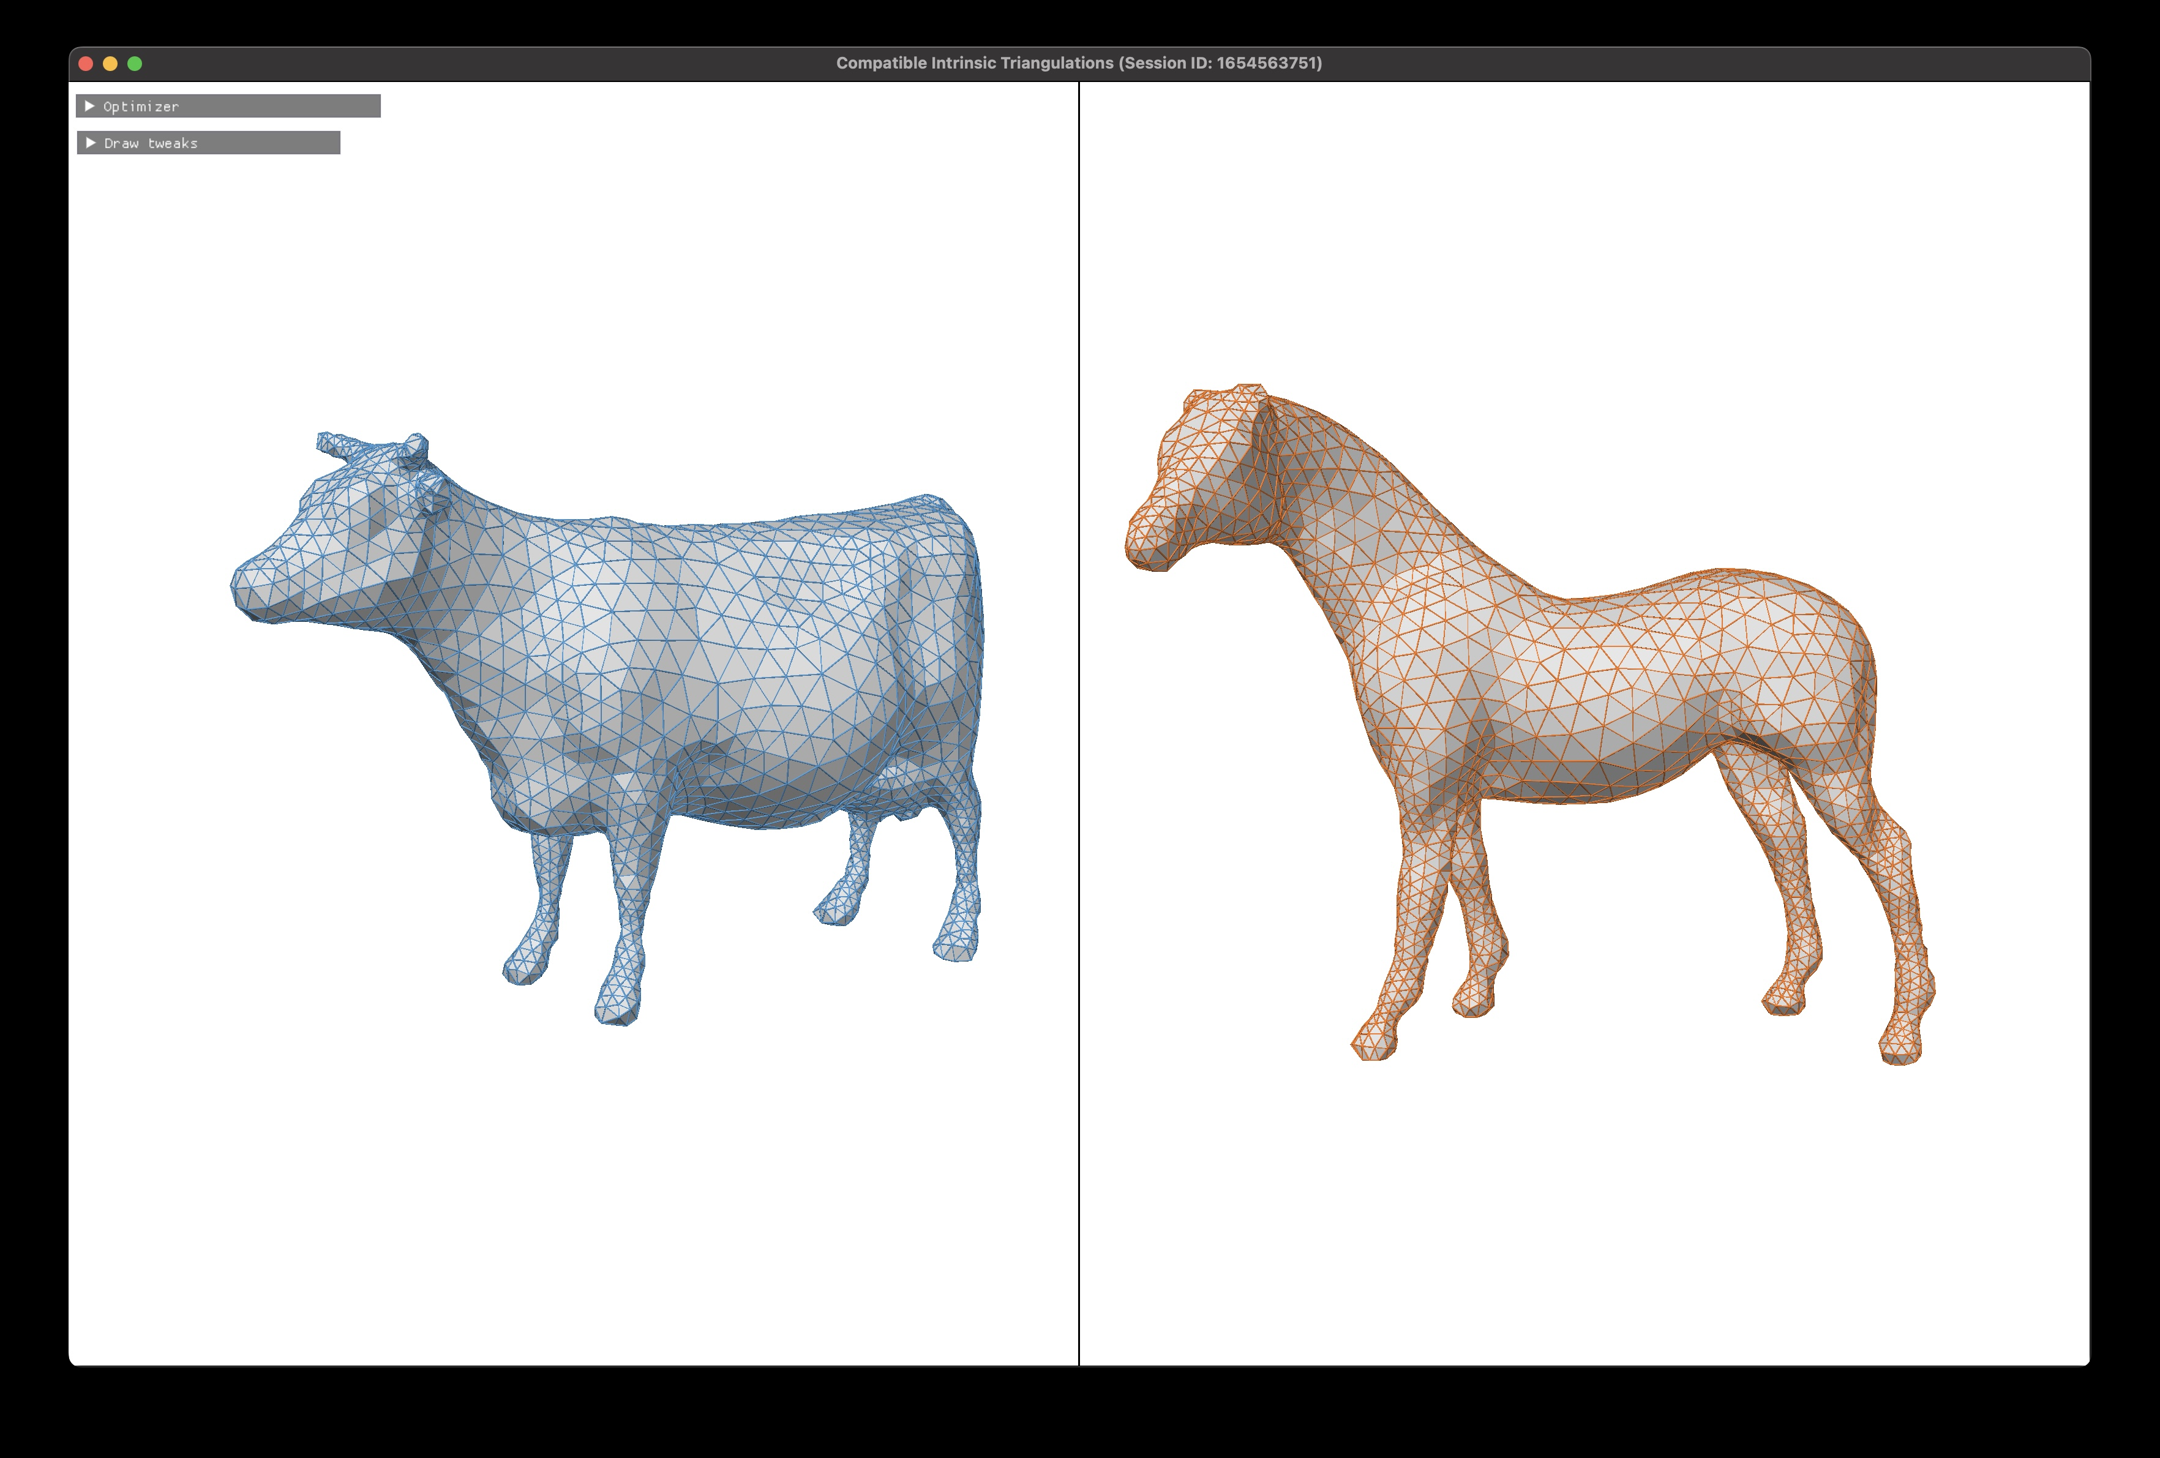
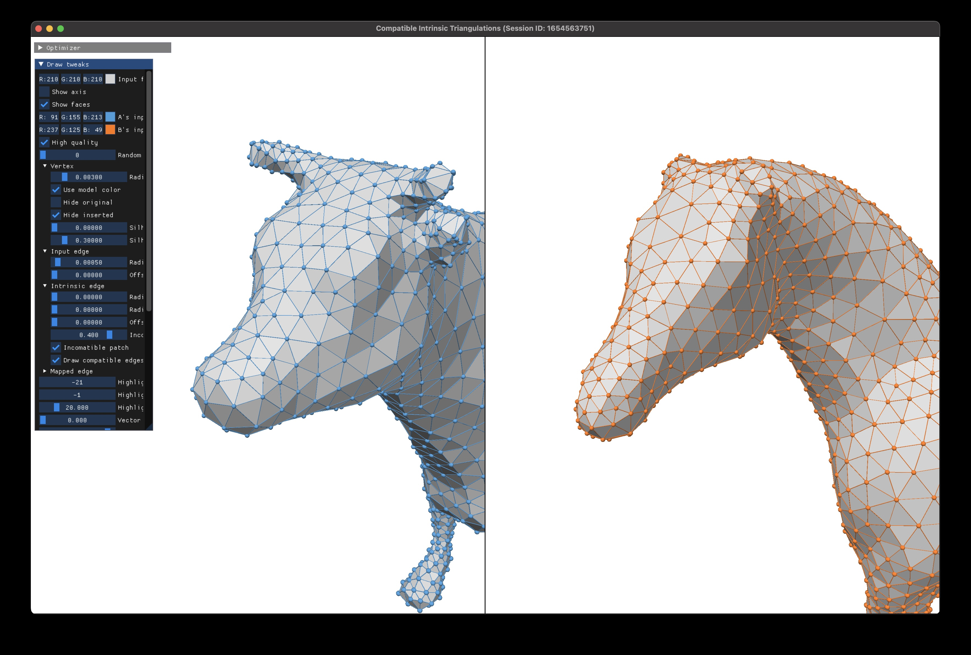
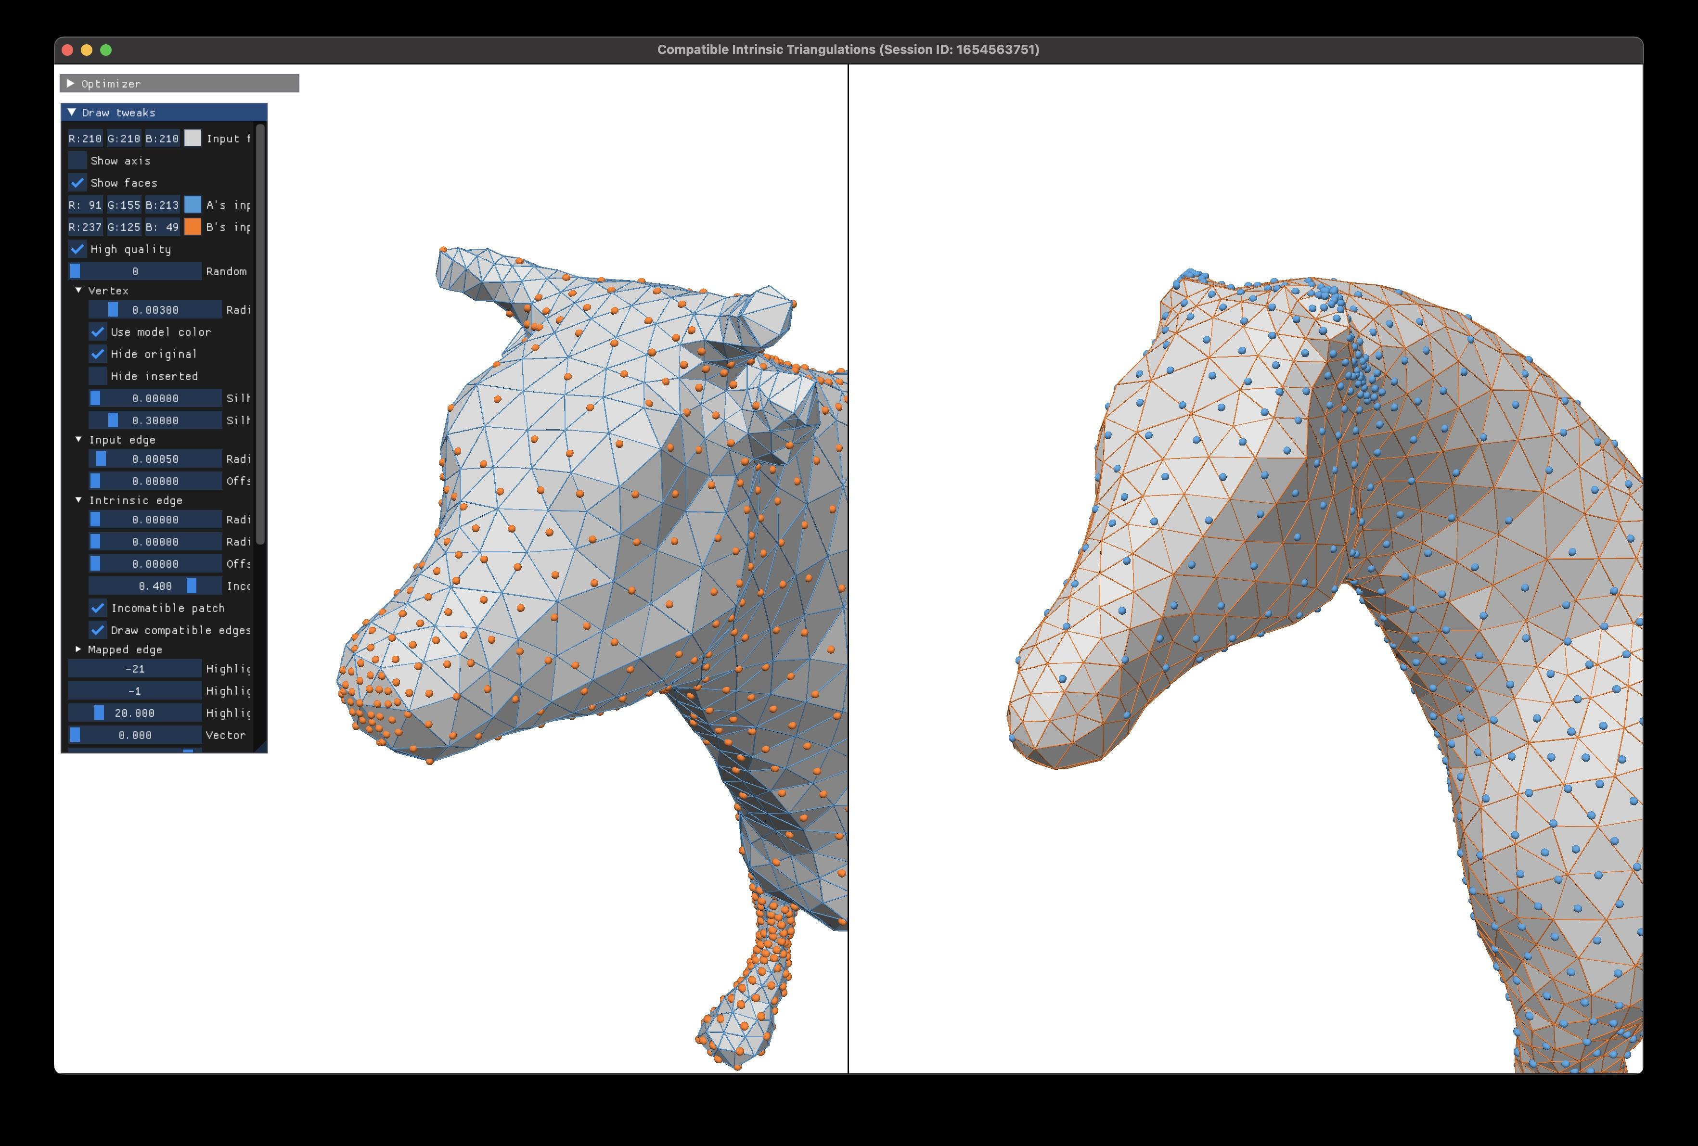
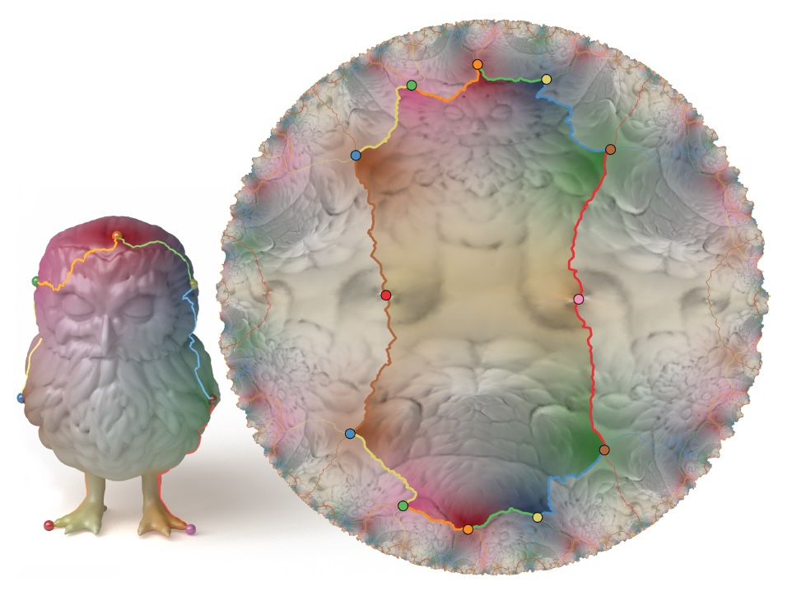
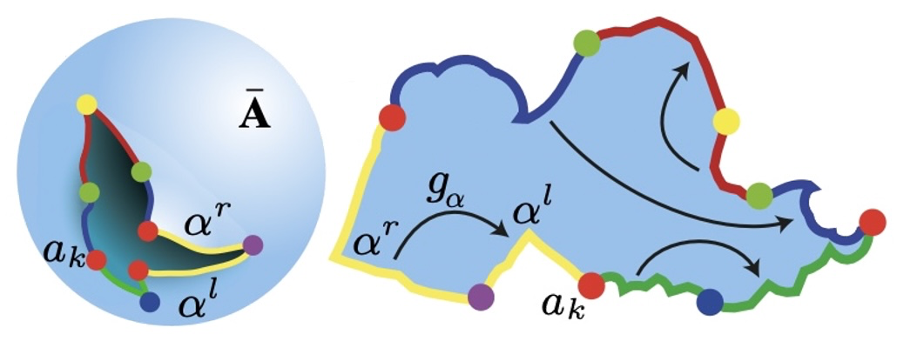
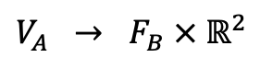
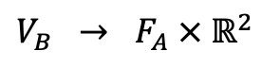
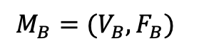
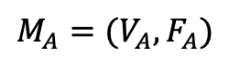
入力: ”頂点イメージ”
$$M_{A}=(V_{A},F_{A})$$
$$M_{B}=(V_{B},F_{B})$$
重心座標
$$V_{A} → F_{B} × ℝ^{2}$$
$$V_{B} → F_{A} × ℝ^{2}$$
A
B
A
B
ある程度良い品質であることを仮定
既存法で生成
[Aigerman 2016]
[Aigerman 2015]
Notes:
First of all, we’re given a pair of triangle meshes of the same genus, A and B.
<NEXT> In addition to these, we take as input something called “vertex images”.
<NEXT> It’s simply an assignment to each vertex of A, a position on the surface B, expressed using barycentric coordinates.
<NEXT> We take another vertex image in the opposite direction as well.
<NEXT> Importantly, we assume that these vertex images are of some good quality; they must not be some random inconsistent assignments, otherwise our algorithm will fail.
<NEXT> And they can be generated using any of the existing methods.
Specifically, we used these in our work.
Far view:
1.24226 0.269773 -1.61191 0.228322 0.0189025 -0.0941629 -0.0801198 0.990672 0.110225 0.183065 0.339927 -2.22952 -0.0317966 0.104764 -0.144722 -0.0747331 0.991748 0.104166
Edge radius 0.00050
Closeup view:
0.858345 0.427905 -0.405501 0.512988 0.213362 -0.00688754 -0.292864 0.924532 0.243869 0.306015 0.64384 -0.847461 0.356392 0.401196 -0.235346 0.00477354 0.929749 0.368162
Vertex radius 0.00400

Slide 10
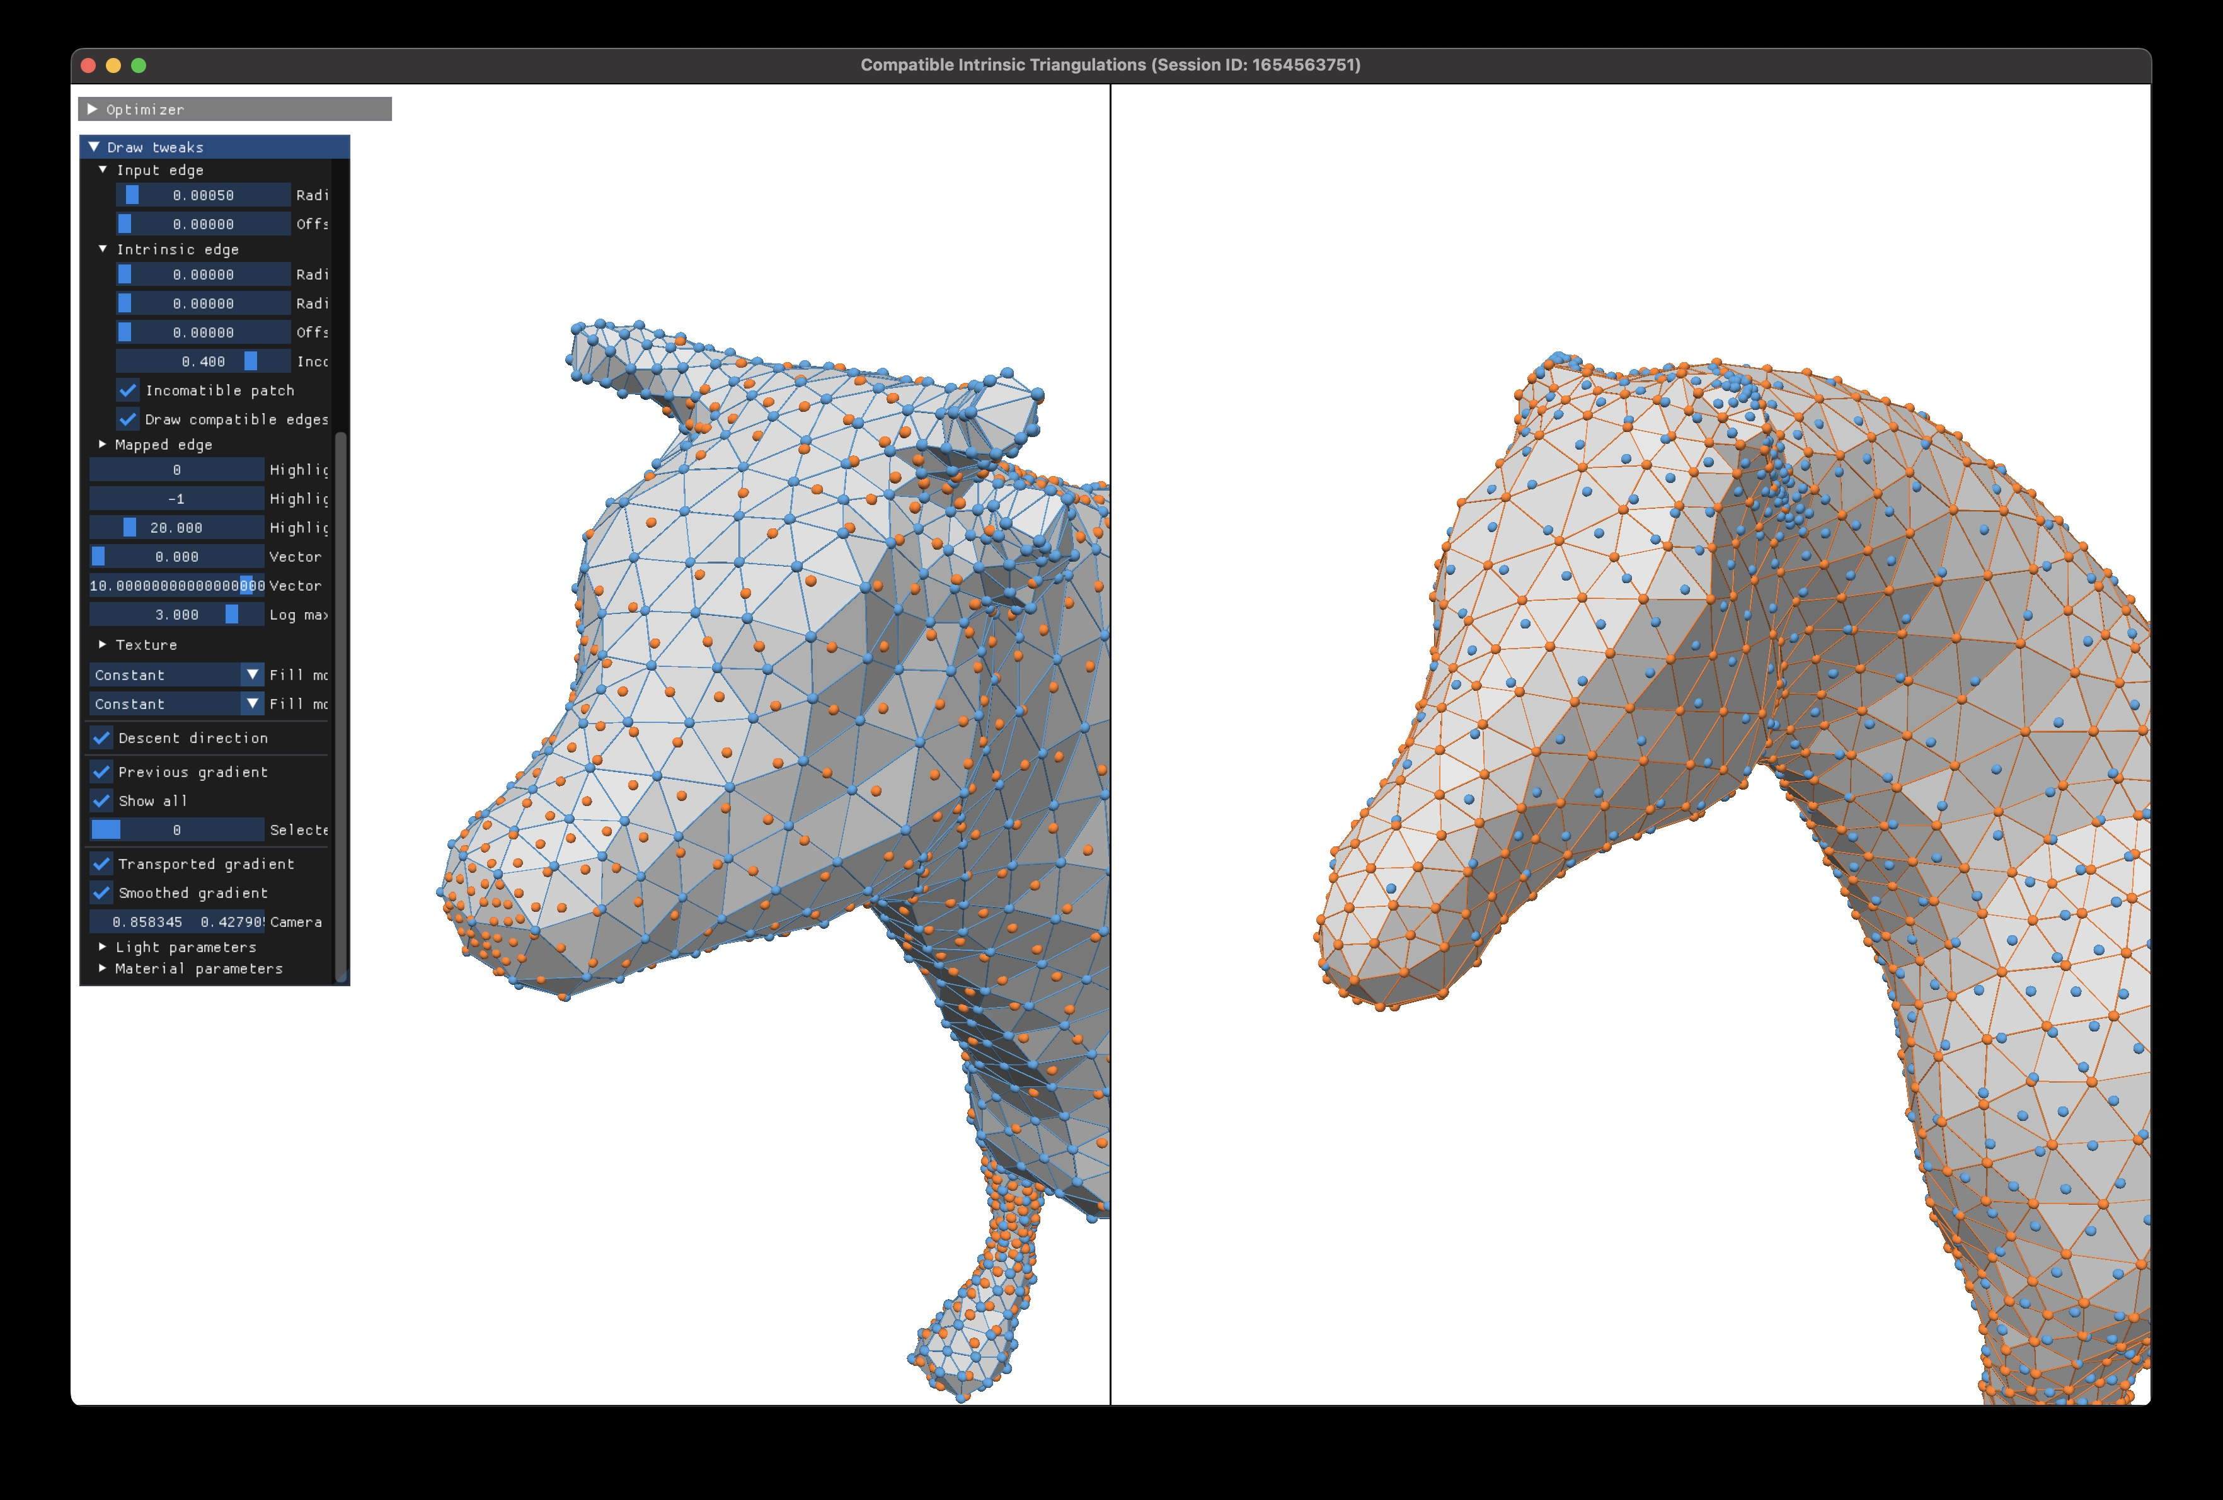
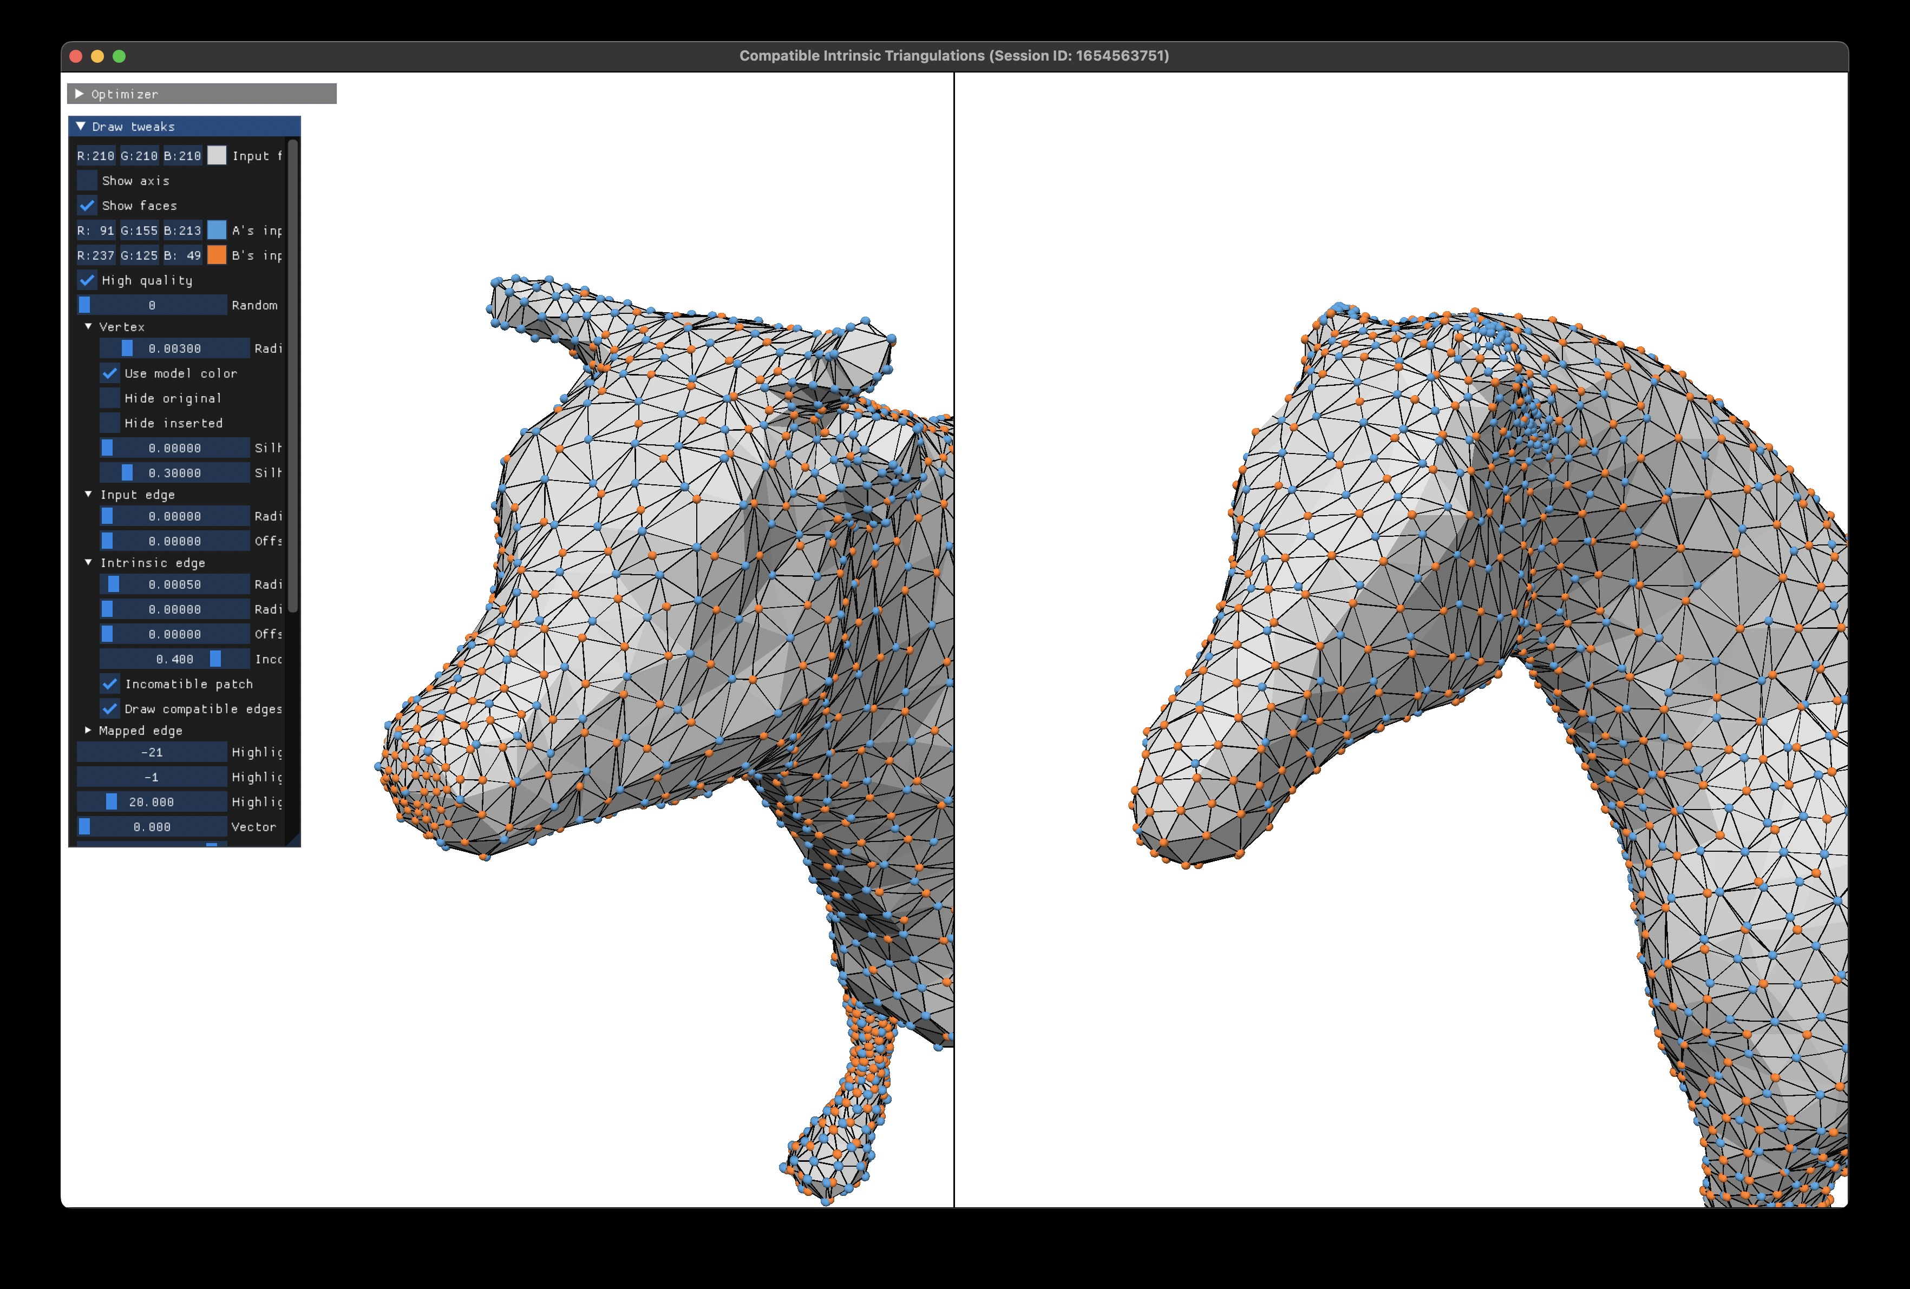
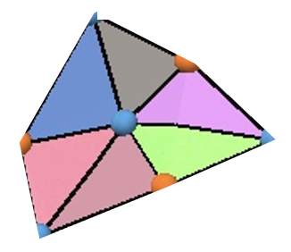
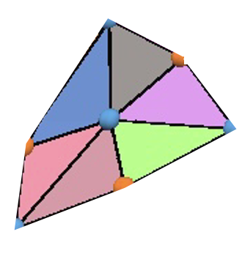
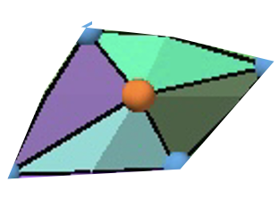
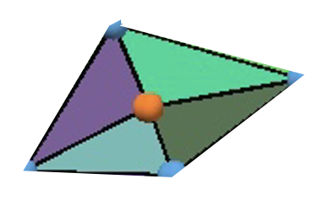
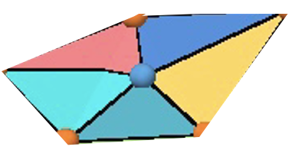
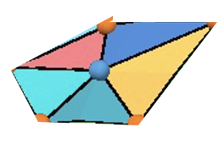
出力: Compatible Intrinsic Triangulation (CIT)
Input
Output
A
B
A
B
AとBそれぞれの上に定義された intrinsic triangulation
各三角形が一対一で対応付けられている
Notes:
Our output is a Compatible Intrinsic Triangulation, or CIT in short.
It’s an intrinsic triangulation on each of A & B.
<NEXT> And it is constructed in such a way that every face is in 1-to-1 correspondence.
<NEXT> Here I highlight some corresponding faces <NEXT> around vertex <NEXT> one rings.
40.84 cm

Slide 11
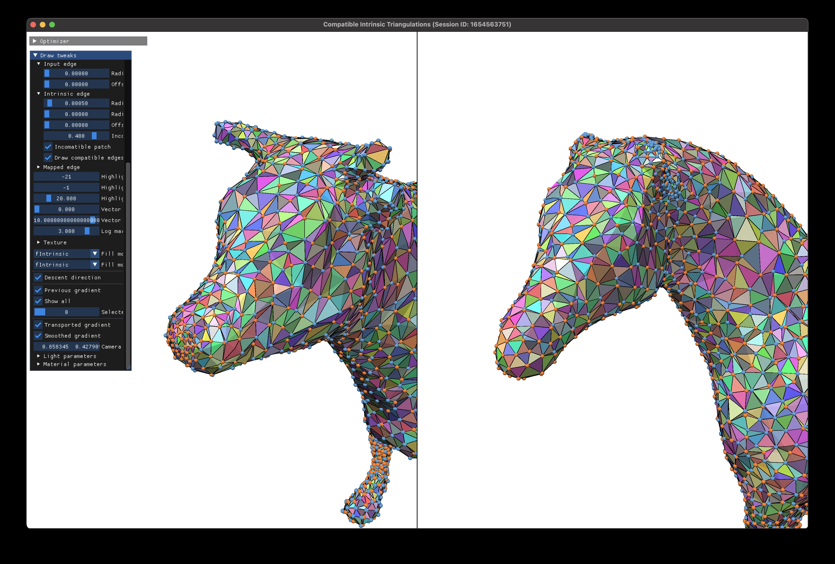
Output: Compatible Intrinsic Triangulation (CIT)
Input
Output
A
B
A
B
AとBそれぞれの上に定義された intrinsic triangulation
各三角形が一対一で対応付けられている ➔ 同相写像!
Notes:
So this is our new way of defining homeomorphisms between surfaces.

Slide 12
CIT 生成アルゴリズム (4 ステップ)
Notes:
So, how do we generate it?
Our algorithm mainly consists of 4 steps.

Slide 13
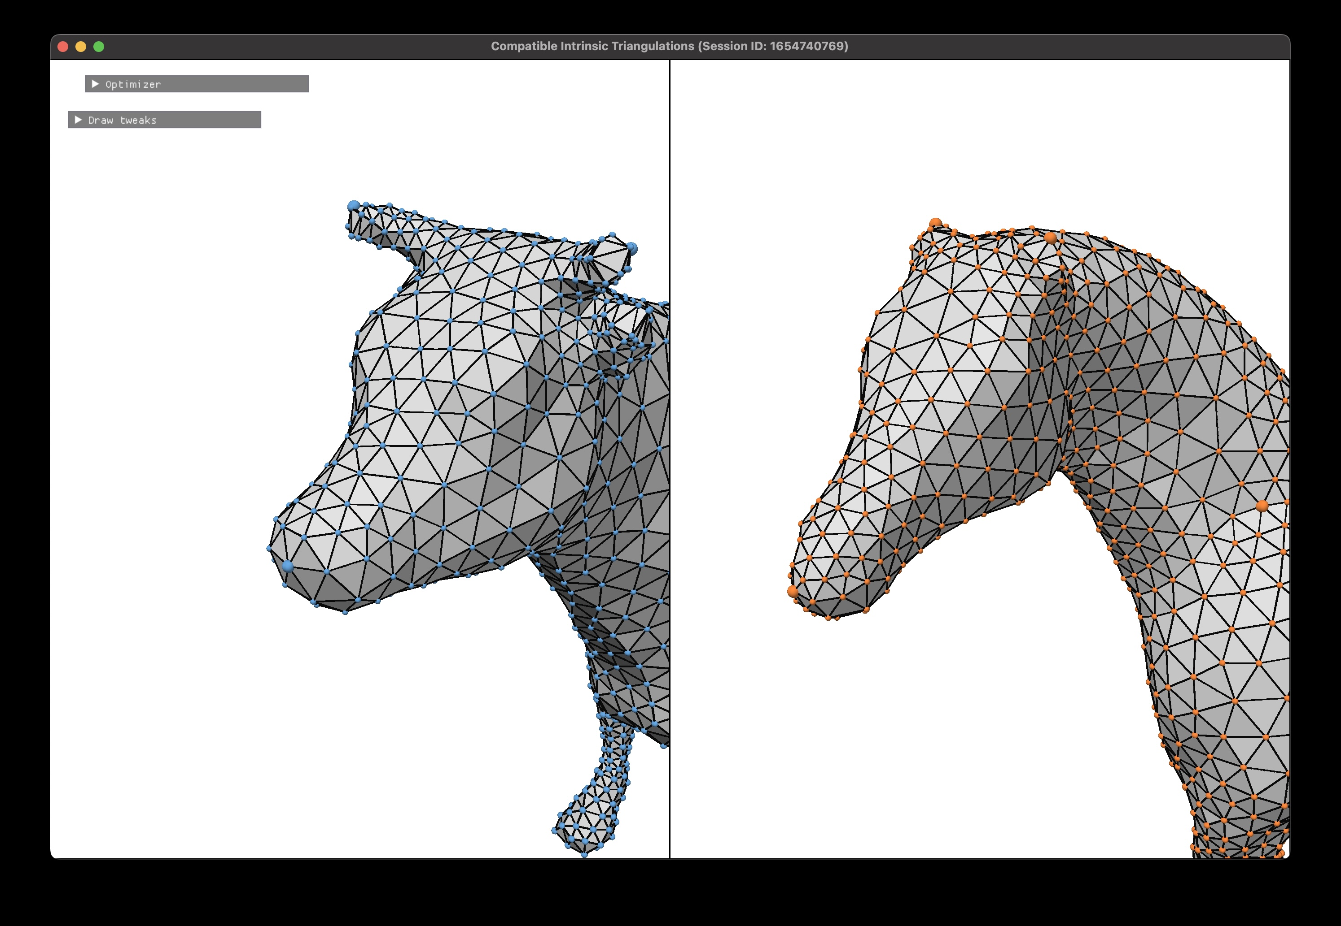
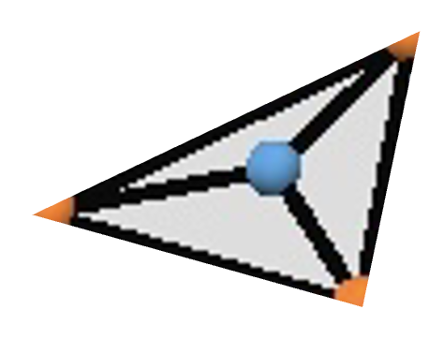
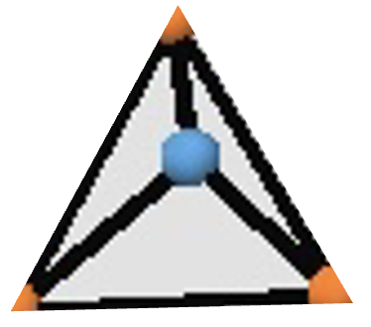
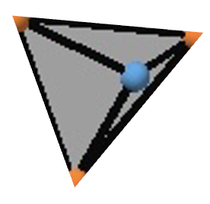
Step 1: 頂点の挿入
A
B
Notes:
The first step is vertex insertion, which is very simple.
According to the input vertex image, <NEXT> we simply insert A’s vertex to B, <NEXT> one by one, <NEXT> splitting triangles into three.
Width=40.84
A:
Horizontal pos = -9.14 cm
Vertical pos = -6.87 cm
B:
Horizontal pos = -16.44 cm
Vertical pos = -6.87 cm

Slide 14
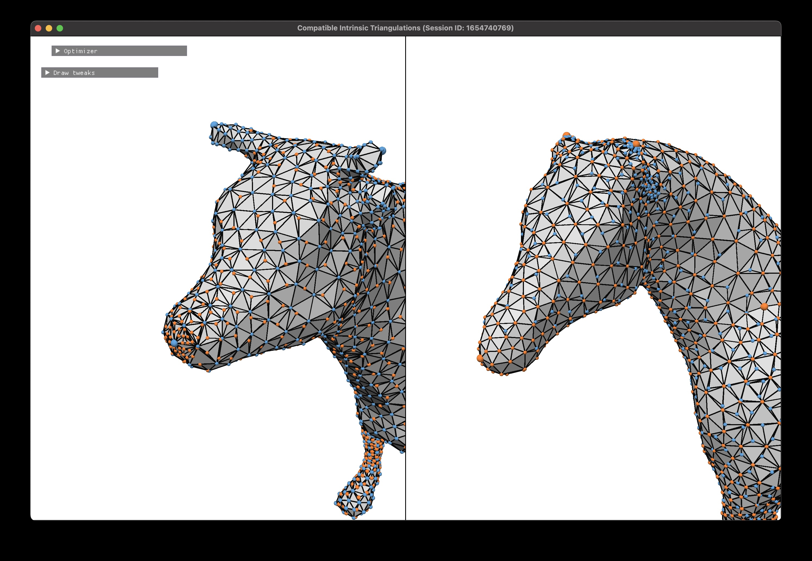
Step 1: 頂点の挿入
A
B
Notes:
And we end up with something like this.
<NEXT> We do the same in the opposite direction as well.

Slide 15






Compatible edges という概念
A
B
Notes:
Now I’d like to introduce the notion of compatible edges.
<NEXT> First of all, recall that every vertex is <NEXT> already in 1-to-1 correspondence, <NEXT> by definition.

Slide 16
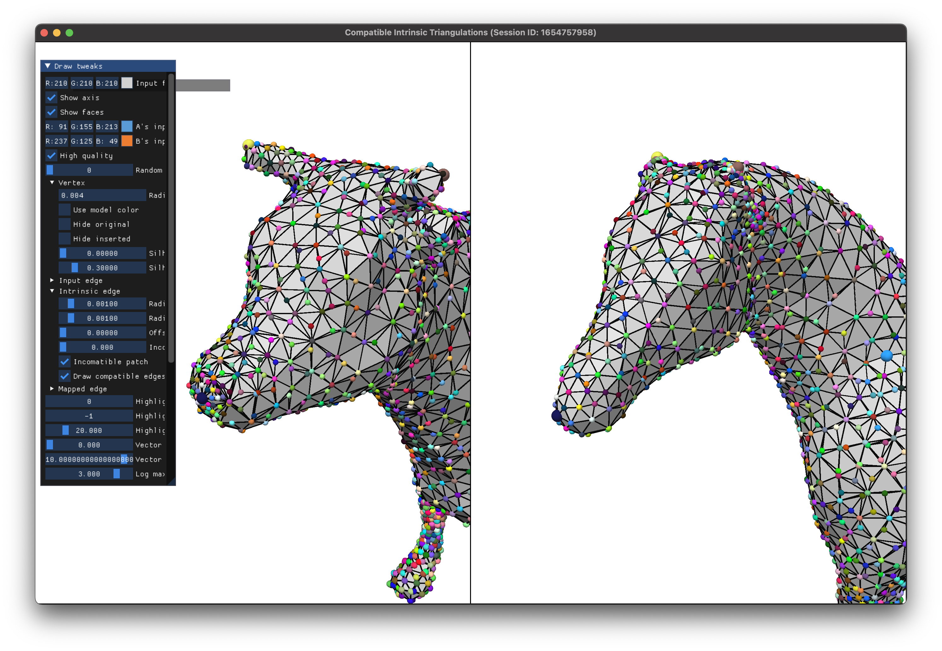
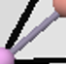
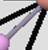
Compatible edges という概念
A
B
Compatible!
(色でIDを表示)
Notes:
So we assign random colors to corresponding vertices.
Then, let’s look at edges.
<NEXT> For example, this edge on A connects these two vertices.
If we look for the same pair of vertices in B,
<NEXT> we see that there is an edge connecting them.
So we call this edge compatible, and assign a random color to it representing its ID.

Slide 17
Compatible edges という概念
A
B
Incompatible!
(黒で表示)
Notes:
OK, now let’s look at this edge.
<NEXT> If we look for the same pair of vertices in B, we see that there is no edge connecting them, so we call this edge incompatible, and show it in black.

Slide 18
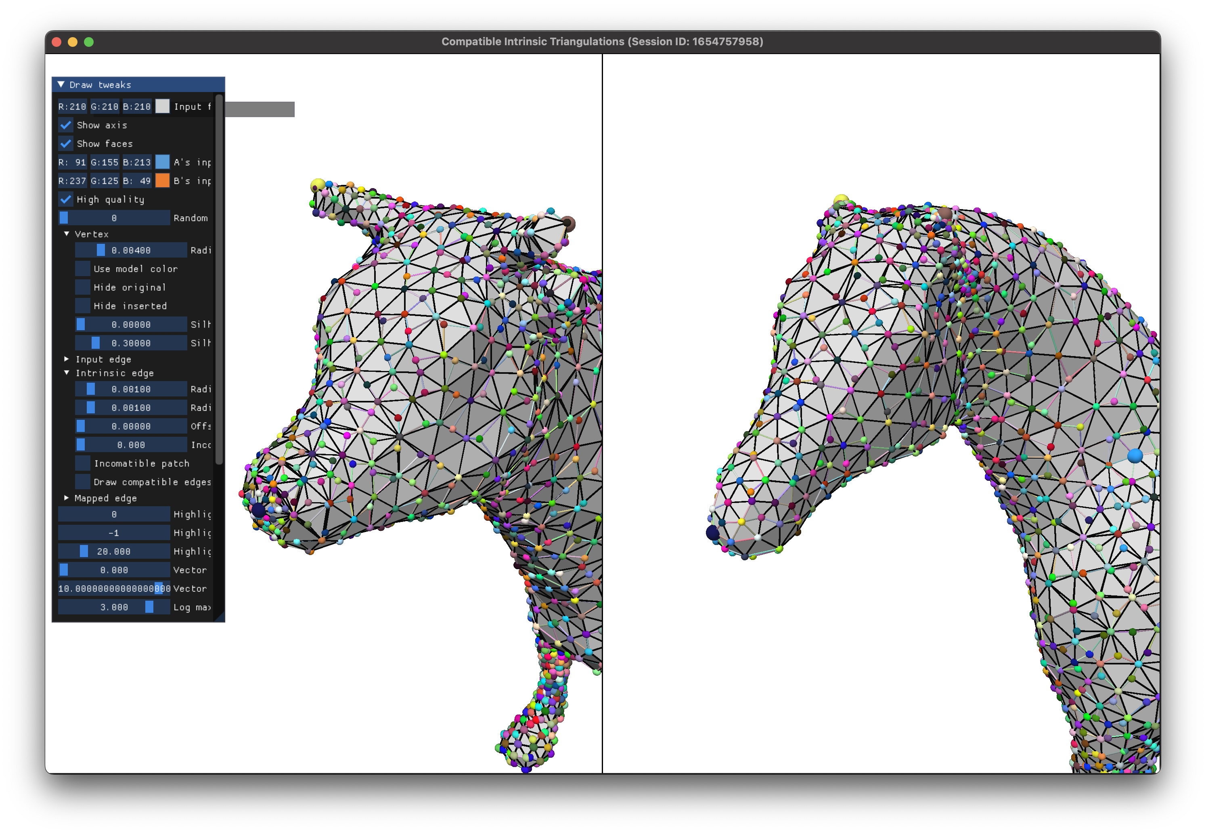
Compatible edges という概念
A
B
ほとんどのエッジが
incompatible ☹
目標: すべてのエッジをcompatibleにする!
Notes:
Using this edge coloring scheme, we see that after the vertex insertion step, most edges are incompatible.
<NEXT> Our goal then is to make all the edges compatible; if we succeed in doing so, all the faces become compatible, and we get a homeomorphism!

Slide 19
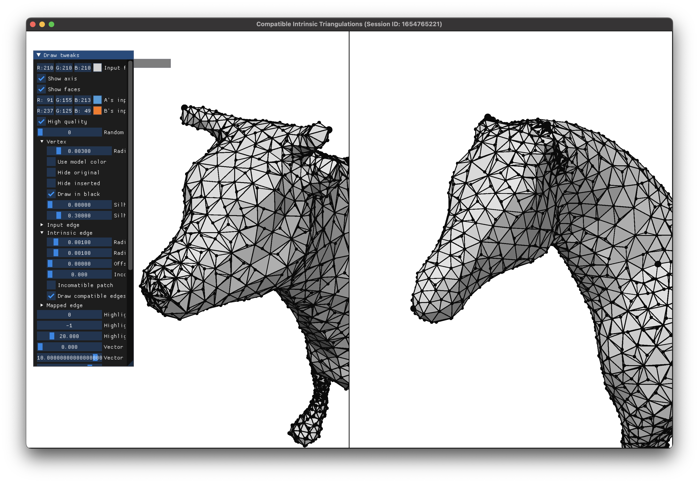
Step 2: Delaunay flip [Sharp 2019]
A と B それぞれに対して別々に実行
A
Before
Notes:
Our step 2 is Delaunay flipping, which was originally proposed by Sharp et al.
And this is done separately for each of A & B.
The idea is very simple:
<NEXT> for every edge, we look at its two opposite corners, and sum their angles.
<NEXT> If it’s larger than pi, we flip the edge, <NEXT> intrinsically.
<NEXT> We repeat this until there are <NEXT> no more edges to flip.
This process is known to converge in finite steps.

Slide 20
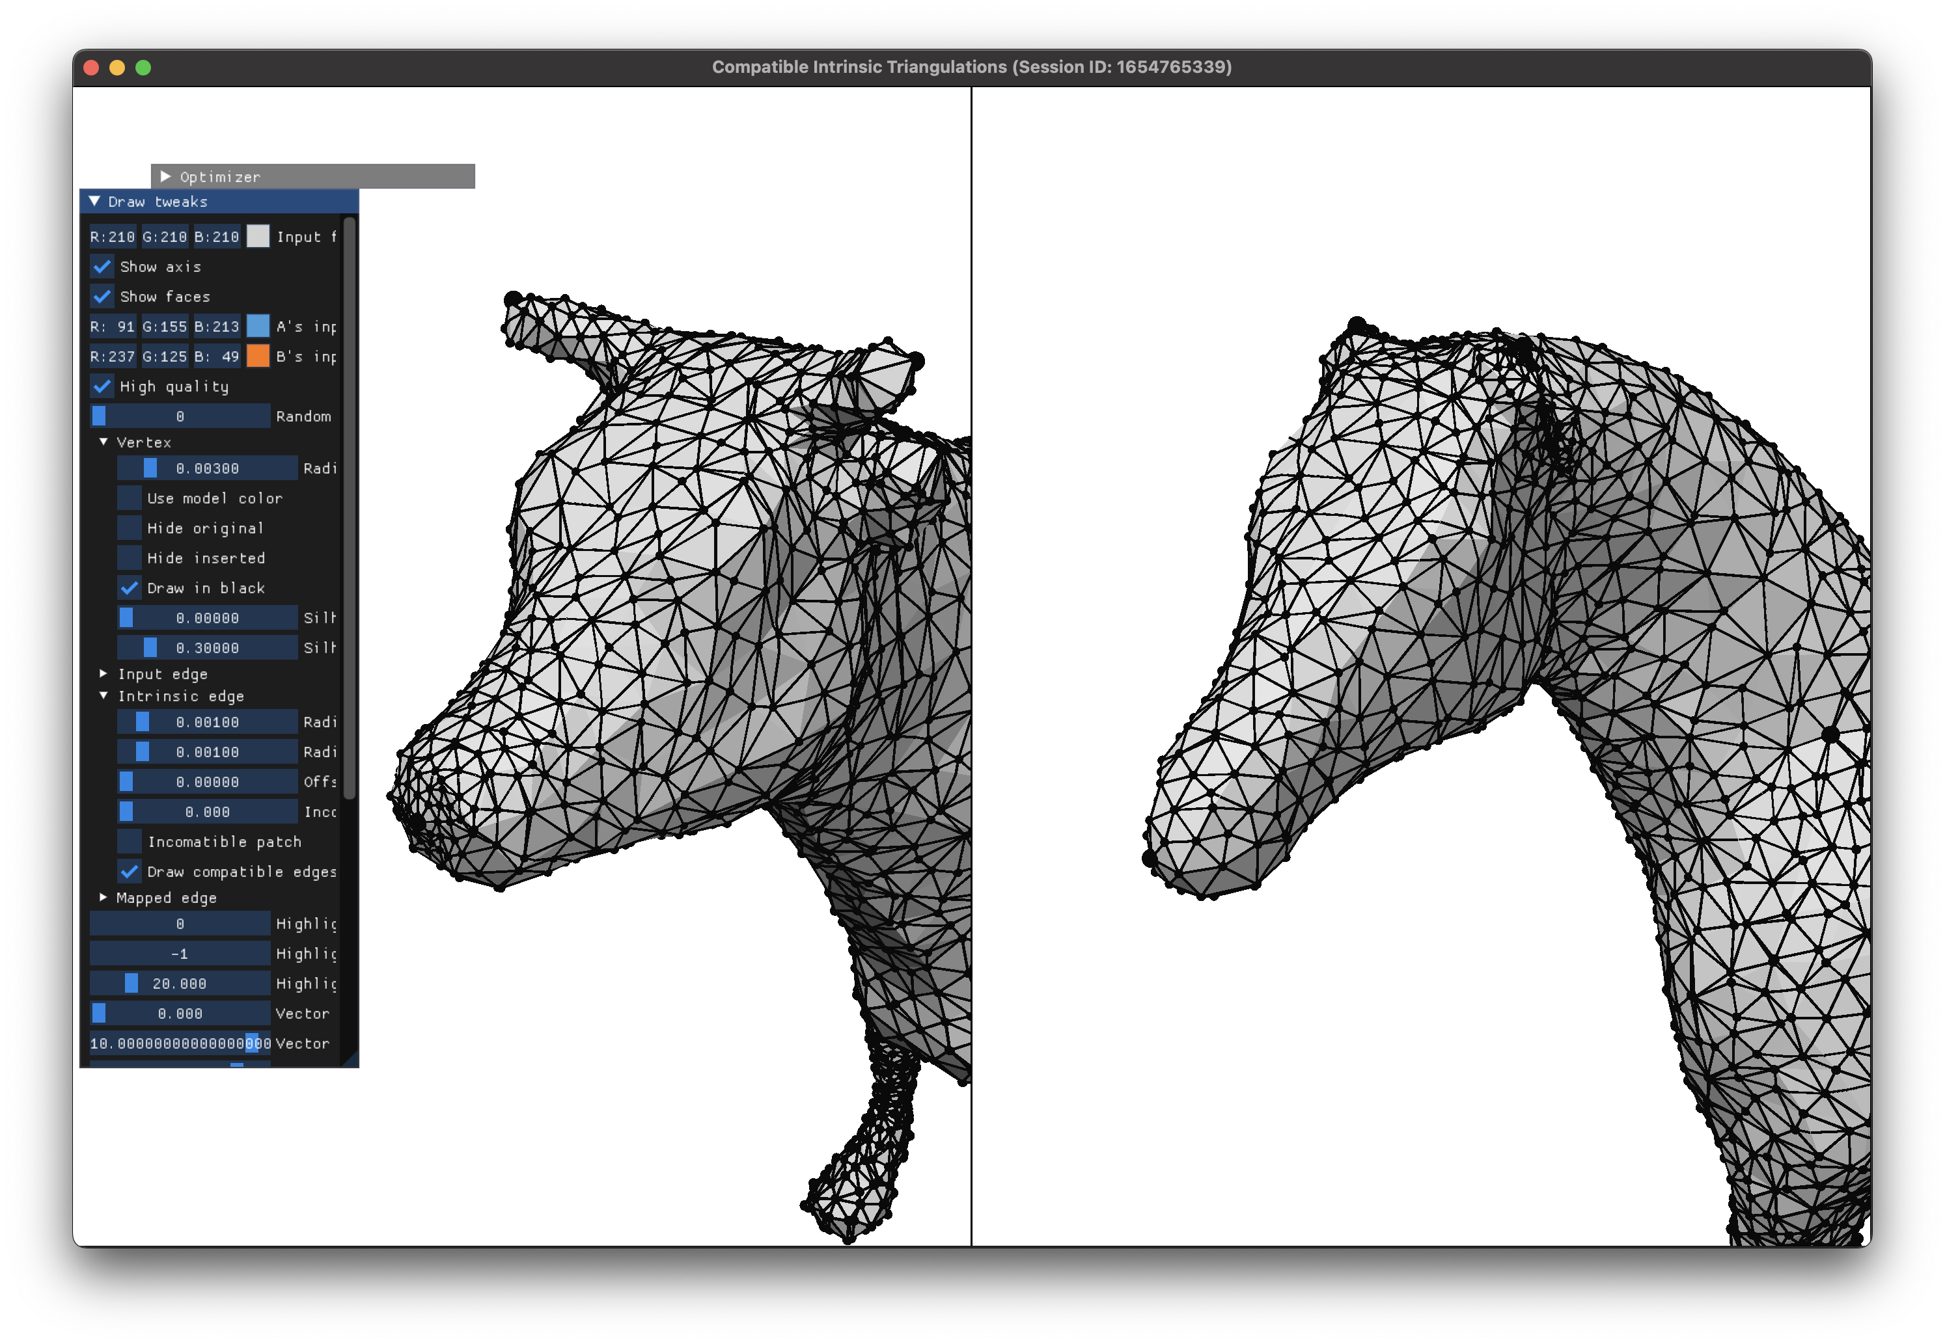
Step 2: Delaunay flip [Sharp 2019]
A と B それぞれに対して別々に実行
A
B
Before
After
After
Notes:
We do the same on the other surface as well.

Slide 21
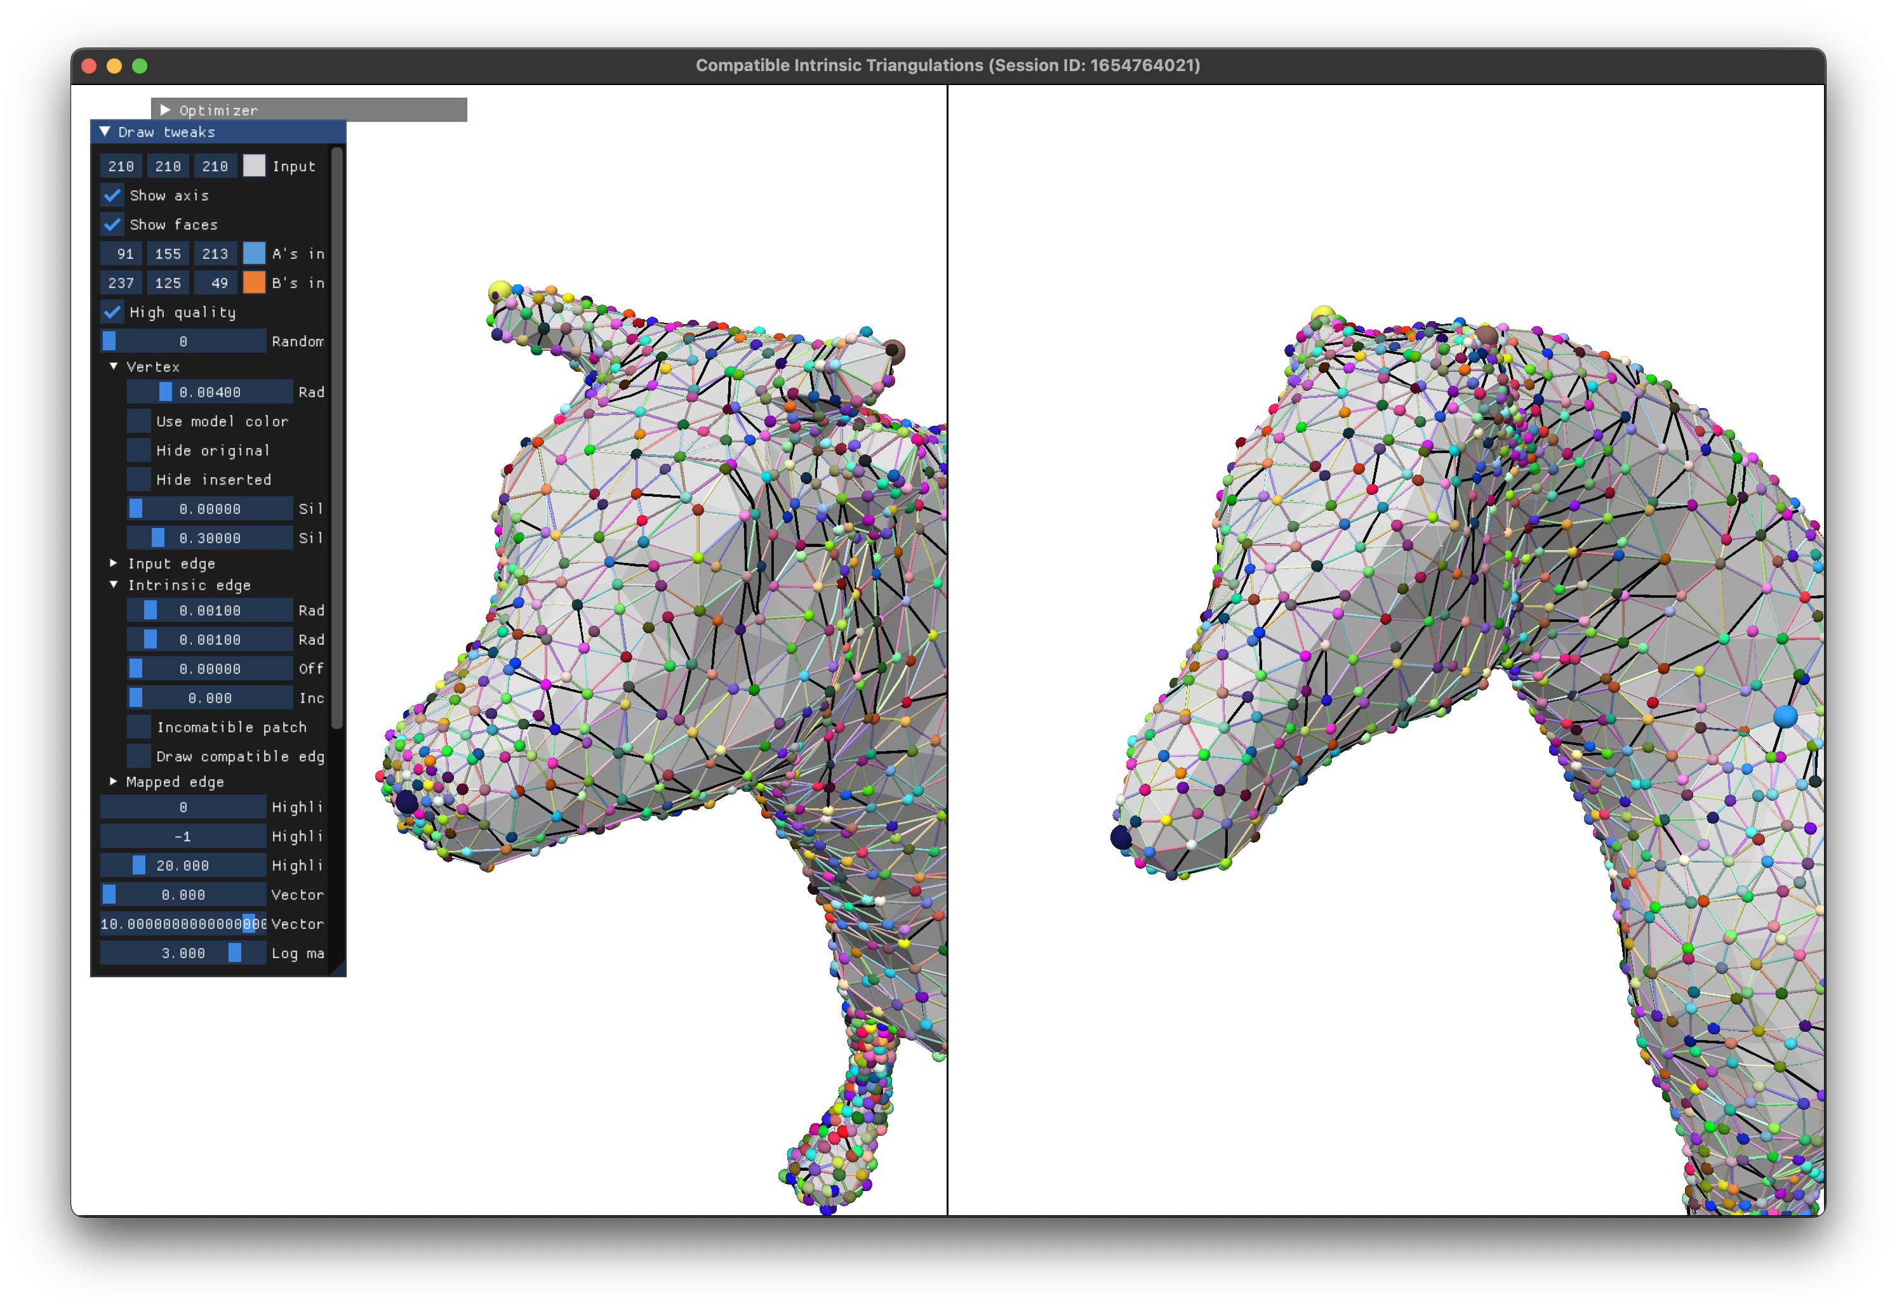
Step 2: Delaunay flip [Sharp 2019]
A と B それぞれに対して別々に実行
多くのエッジが既にcompatible!
残るタスク: incompatible edges を直す
A
B
Step 3: エッジの切り替え
Step 4: 頂点のマージ
Notes:
Now, if we check for the edge compatibility, we see that most edges are already compatible at this point!
This is thanks to our assumption that the input vertex images are of some good quality.
Our remaining task then is to fix these sparsely distributed incompatible edges, one by one.

Slide 22
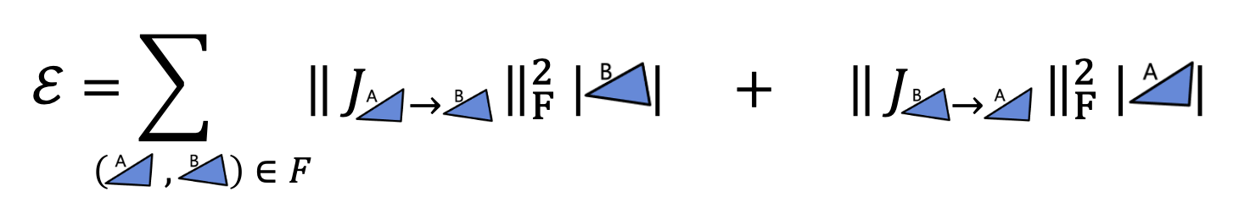







写像の最適化
Symmetric Dirichlet energy
勾配とヘシアンを自動微分で計算
新しい頂点イメージに対してCITを生成
A
B
$$ℰ=\sum_{ }{ }$$
$${\left\| J_{ → } \right\|}_{F}^{2} \left| \right|$$
$$+$$
$${\left\| J_{ → } \right\|}_{F}^{2} \left| \right|$$
$$\left( , \right)∈F$$
A
B
Notes:
We adopt the same modified Newton scheme as in the previous work.
<NEXT> We used the same symmetric Dirichlet energy as the measure of distortion.
This can be trivially computed once we have a CIT:
<NEXT> for each intrinsic face, we know its 2D triangle shape on A and B,
<NEXT> so we get a 2 by 2 Jacobian matrix mapping one triangle to the other in some 2D coordinate frame.
We just add up its Frobenius norm squared weighted by the triangle area.
<NEXT> We compute the energy’s gradient and Hessian using automatic differentiation.
<NEXT> We then solve for the descent direction, followed by a line search.
<NEXT> At every search step, we generate a CIT with the new vertex images.

Slide 23
評価実験
Notes:
Now comes the evaluation part.

Slide 24


先行研究 [Schmidt 2020] のデータセットで実験
Ours
[2020]
全てのケースで成功
同じようなエネルギー値に収束
難しい2個のケースを除く
Notes:
We ran our algorithm on the dataset released by the previous work.
And we achieved similar or slightly better energy for all but two cases.
<NEXT> These two exceptional cases are highly non-isometric, and our algorithm easily got stuck in local minima.

Slide 25

Princeton データセット [Chen 2009] で実験
ランダムに88個のペアを選択
81個のケースで成功 (92%)
Notes:
To assess the practicality of our method, we did a robustness test on the Princeton dataset.
It consists of 19 categories, and we randomly picked 5 pairs per category, totaling in 95 pairs to test.
<NEXT> Out of these, HOT, the method we used to generate the input vertex images, failed on 7 cases no matter how we chose the landmarks.
<NEXT> So, we tested our method against the remaining 88 pairs.
<NEXT> Out of these, our method succeeded in 81 pairs, meaning a success rate of 92%.

Slide 26








A
B
A
B
初期状態
最適化後
初期状態
最適化後
A
B
A
B
初期状態
最適化後
初期状態
最適化後
Notes:
Here are some samples of our test results.
We can visually confirm that our optimization does indeed reduce the mapping distortion, as indicated by the smoother checkerboard patterns on the right.

Slide 27




Limitations
Incompatible edges
[Schmidt 2020]
場合によっては失敗する
局所解に陥りやすい
[Jiang 2020]
大きなメッシュに対して遅い
➔ bijective projectionによる多重解像度での計算
Notes:
Our work has a number of limitations and future directions to explore.
<NEXT> First, our algorithm is purely empirically designed with no guarantee of success, and it sometimes fails.
In this failure example, the initial vertex images are very strongly distorted, resulting in large clusters of numerous incompatible edges, which our algorithm could not get rid of.
We believe more thorough analysis of our problem setting is crucial, and we hope to get some kind of theoretical guarantee.
<NEXT> Another issue is that our algorithm is quite prone to getting stuck in local minima.
To improve this, we’d like to find a way of smoothing out the mapping distortion more effectively, perhaps by mimicking the “metric regularization” technique used in the previous work.
<NEXT> Lastly, our method is very slow on large meshes;
A multiresolution approach is a natural direction to explore, and perhaps a recent technique of bijective projection in a shell by Jiang et al. could be utilized.

Slide 28
採択までの道のり

Slide 29





タイムライン
小山裕己さん
https://siggraph.xyz/
EG19で
論文発表 (hex mesh)
新しい研究テーマを探し求めて苦闘
S19参加
2019
Jan
Feb
Mar
Apr
May
Jun
Jul
Aug
Sep
Oct
Nov
Dec
SA19勉強会 (3)
初歩的なバグを直し、
確信を得る
S19勉強会 (6)
S20勉強会 (3)
ひたすら実装
2020
Jan
Feb
Mar
Apr
May
Jun
Jul
Aug
Sep
Oct
Nov
Dec
最初の着想を得る
妊娠が判明
S21
投稿
S21
不採択
ひたすら実装＆実験
長男誕生
転職活動
2021
Jan
Feb
Mar
Apr
May
Jun
Jul
Aug
Sep
Oct
CA内定
Nov
Dec
S22
投稿
S22
採択
S22
最終版提出
2022
CA入社
Jan
Feb
Mar
Apr
May

Slide 30

初回投稿時
時間が足りず、小規模な実験 ([Schmidt20]と同じ10個のペア) のみ
好意的なコメント
アイディアはユニークで面白い
そこそこの結果が出ている
批判的なコメント
一部の例で失敗している。実際は多くのケースで失敗するのでは?
査読者の結論
[Schmidt20]のコードが非公開であるため直接比較はしなくてもOKだが、
ある程度多くのケースで実験して、ロバスト性を示すべき

Slide 31




再投稿時
g=1
g=3
唯一の変更点: Princetonデータセット (88個のペア) で実験
Genusが1以上の場合にきちんと対応するために、 既存法をフルスクラッチで再実装 (超大変!)
色々な手作業が発生
適切なLandmarkの配置
メッシュのクリーニング
膨大な数のファイルの整理・編集
安東遼一さん宅の計算機クラスタ環境を利用
(実験以外は一切何も変更できず。。。)
好意的なコメント
最も重要なポイントが改善されている
批判的なコメント
実験以外のコメント (作文等) が無視されている! ひどい!
リバッタル
限られた時間でベストを尽くしたらこうなった。その他の修正はRevision期間中に必ずやります!
Seamless Surface Mappings
[Aigerman 2015]

Slide 32
感想
一人で研究するのは、不可能ではないが大変
新しい研究テーマを見つけるのは、本当にいつも大変
自分的に面白いと思えるアイディアなら、既存法を性能面で凌駕できていなくても、研究として認められることもある (運が良かった?)
純粋な思いつきで始まった：Intrinsic Triangulation × Inter-Surface Mapping
その結果どんな優位性が出るかは未知だった

Slide 33
Thank you!
https://github.com/kenshi84/compatible-intrinsic-triangulations
Notes:
This concludes my talk, thank you for your attention!
The source code is available in the URL shown below.

